Slide 1
Common Core Unit Alignment Erie 2 Math Updates/ Tri-State Feedback Tool
Patrick Moses
Erie 2 BOCES
Staff Development Specialist

Slide 2
Happy pi Day!!!

Slide 3
IES BOCES Unit Planning Overview
Day 1
“Unpacking” the Common Core
“What do we want students to know?”
“What do we want students to be able to do?”
Essential Questions and Enduring Understandings
Related Misconceptions
Math Considerations
When? Gaps/Scope and Sequence
Curricular Priorities

Slide 4
IES BOCES Unit Planning Overview (Contd.)
Day 2
Learning about the moments of assessment
Baseline/Diagnostic
Formative (Informal and Formal)
Summative
Designing the Summative Assessment
Does it measure the “learning targets” from Day 1?
How well? Level of rigor?
Create assessment and answer key/rubics

Slide 5
IES BOCES Unit Planning Overview (Contd.)
Day 3
Putting it all together
Resource inventory
Day-to-day layout of unit
“Work day”
Final product
Moodle Access

Slide 6
Where is your district?
Creation of 2 units aligned to Common Core
Have your teachers taught any of these units?
Have you/another administrator observed any of these lessons/units?
What evidence do you have?

Slide 7
Tri-State Quality Review Rating Guide
This is the result of the collaboration between states as NYS is trying to collaborate and consolidate the work now that we have shared standards.
THIS IS NOT A RUBRIC… It is a checklist.
SED has intended that it be used as a feedback tool - which is how we are using it (Theresa’s Email)
We modified the format (not the content) of the form so that teachers might use it
- Included the feedback column right next to the checklist
teachers will be more likely to READ the feedback and not just look for their score.

Slide 8
Important Considerations
This has just recently become available
Teachers did not have this “rating” guide when developing units
This should be used as a guide for you/teacher to have a discussion about how they can more align their instruction to Common Core expectations

Slide 9
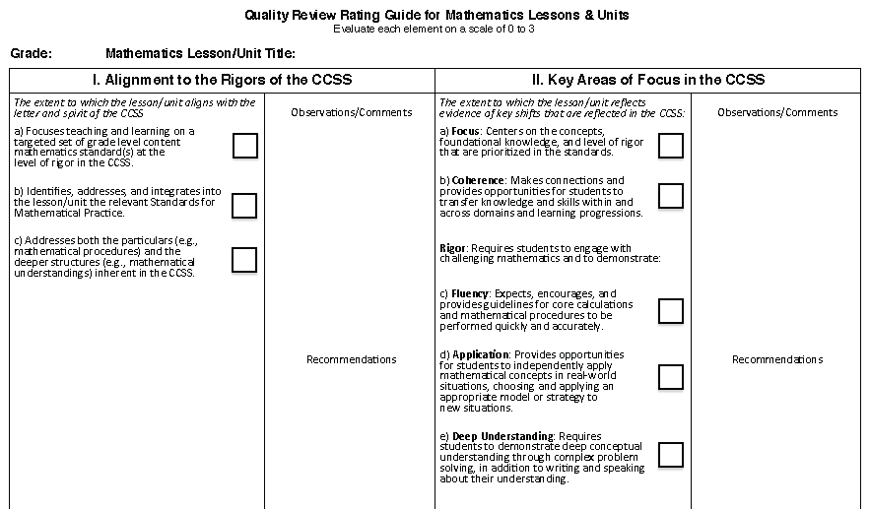

Slide 10
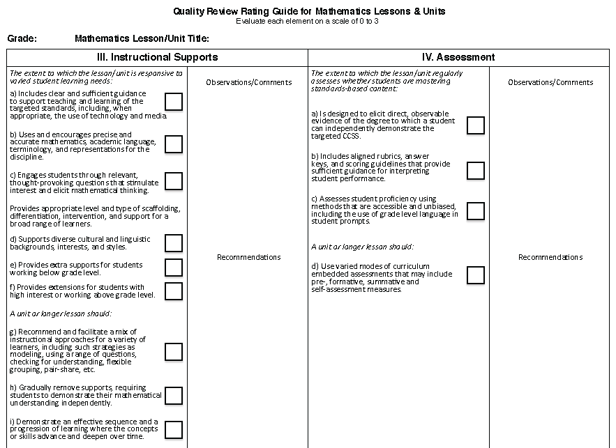

Slide 11
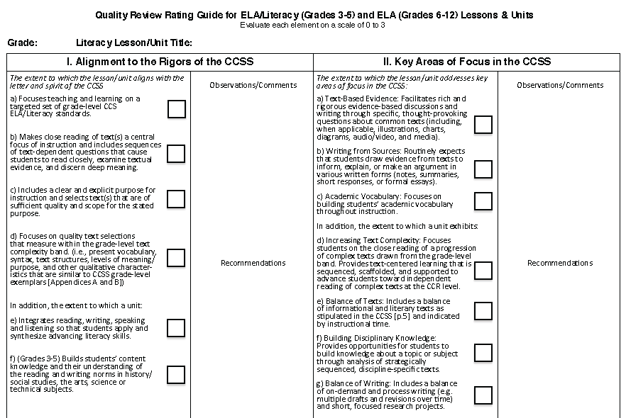

Slide 12
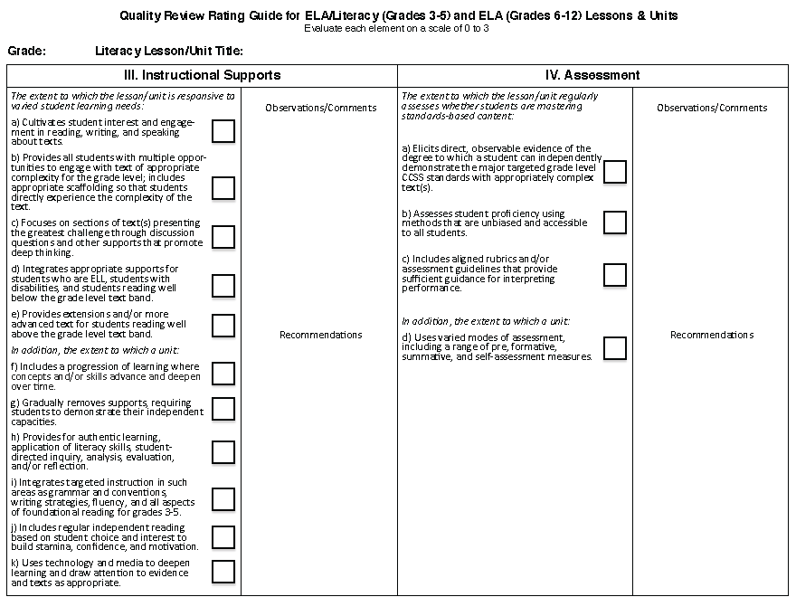

Slide 13
Using the Evaluation Tool
With a partner, utilize the evaluation tool to evaluate the example unit plan template along with unit summative assessment.
Discuss with your table
Share large group
Questions/Concerns this tool raises

Slide 14
Important Updates for Math
NYSED Curricular Priorities Change
(70%-20%-10%)
Now aligns with PARCC
Language
Standards
Priorities
No changes at HS Level
No changes K-2

Slide 15
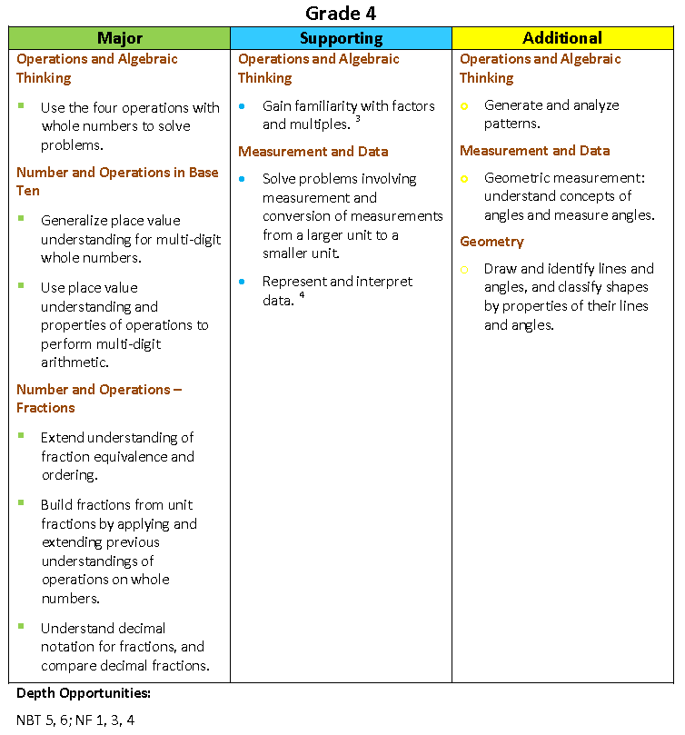

Slide 16
Important Updates for Math (Contd.)
8 Mathematical Practices Evaluation Rubric
Most important/helpful when completing the unit plan daily outline
Through the lens of the 6 Shifts and 8 Mathematical Practices
How do we incorporate these “Good Habits of Mathematical Thinking” into our instruction?

Slide 17
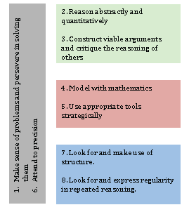
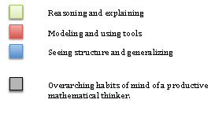

Slide 18
Important Updates for Math (Contd.)
Illustrative Mathematics site
Example Scope and Sequence documents K-12
Math Forum- Interest in regional collaboration on Scope and Sequence
Building Common Interim Assessments
Sharing of best practices

Slide 19
Reminder
When offering training/workshops to other districts
Please ensure that you include a sign-in sheet that lists ALL attendees for any/all schools
Important for PD record keeping
Important for sub reimbursements

Slide 20
2011
-
2012
E2CCB
-
Integrated Education Services
Theresa Gray, Coordinator
Race
-
To
-
The
-
Top: Collaborative Training
CCLS
APPR
Inquiry Team Training
OR
School Improvement Day
(CoSer 565)
Workshop
Title: _______________
____
Date
:
__________________
__________
Time:
____________________________ (Full Day or Half Day)
District Hosting/
Location:
____________ (District Being Billed)
Presented by:
_____________________
District
:
District
:
(Please
print
name clearly)
(Please
print
name clearly)

