Slide 1
Student Learning Objectives (SLO)
Regional Curriculum Council
January 25, 2012

Slide 2
Objectives for Today
Review Student Learning Objectives (SLOs)
Prioritize district steps for moving forward with SLOs
Answer questions that can be answered now
Plan for “next steps”

Slide 3
Student Learning Objectives
A student learning objective is an academic goal for a teacher’s students that is set at the start of a course. It represents the most important learning for the year (or, semester, where applicable). It must be specific and measurable, based on available prior student learning data, and aligned to Common Core, State or national standards, as well as any other school and district priorities. Teachers’ scores are based upon the degree to which their goals were attained.

Slide 4
What Are Student Learning Objectives (SLOs)?
NYSED Webinar (12.20.11)
Notes:
This slide lays out New York’s own definition of a Student Learning Objective.
Student learning is our priority: it is at the heart of our system. SLOs demand a new level of clarity about what the essential learning is for students.
SLOs offer an opportunity to document the impact that all educators make on students.
In order to document and focus teacher impact, SLOs must be specific and measureable. Setting goals for student learning emphasizes outcomes, rather than inputs. SLOs focus attention on data and outcomes.
SLOs are long-term, measurable academic goals based on as much available prior student learning data as possible. They are aligned to standards (CCSS, State, or national) and district and school priorities.

Slide 5
The Foundations for SLOs
Most Important Learning Curriculum Maps Units Designed with Enduring Understandings | Available Prior Student Learning Data Common Assessments by grade level/content area Baseline/Diagnostic Assessments Vertical communication
Specific and Measureable Student achievement goals (NOT professional goals) SMART goal writing process | Alignment Curriculum and Instructional Units based on standards (state, CCLS, national) District wide goals (CDEP, BOE goals, CEP)
IES/E2CCB (12.20.11)

Slide 6

Alignment of our Priorities and Goals
“Sound strategy starts with having the right goal.”
~ Michael Porter
“Sound strategy starts with having the right goal.”
~ Michael Porter
Notes:
Read and highlight the words that stand out to you.
Discuss as large group – working to ensure that we have a common definition of SLO

Slide 7
School Improvement
District Improvement Plan
Teacher Evaluation
Teacher Growth Plans
Initiative
Teacher Induction
Teacher Performance Standards
Principal Evaluation
School Improvement Plans
Data Teams
PLCs
Assessments/Screenings
Coaching & Mentoring
In-services - PD
Resource Allocation
Adapted From: Marzano, R.J. (2010). Whitepaper: Creating an aligned system

Slide 8
Supporting Improvement Through Alignment and Coherence
Teacher Supervision & Evaluation
Multi-Tier Support
Data Teams
Principal Evaluation
Teaching Standards
Teacher Growth Plans
District Improvement Plan
Initiatives
School Improvement Plans
In-services - PD
Coaching & Mentoring
PLCs
Resource Allocation
Adapted From: Marzano, R.J. (2010). Whitepaper: Creating an aligned system

Slide 9
Outcomes for Students
District
School
Classroom
All Students
All Teachers
All Schools
Evidence and Growth Across All Levels

Slide 10
Identifying Success
In each column identify how each of these groups defines success for a given school, classroom or course for a given year.
District | School | Teachers
Are there particular areas of alignment that you see among the three?
Are there particular areas of misalignment among the three?
Are all of the definitions of success being advocated measurable?
Notes:
As tables, brainstorm the definition of success. (10 minutes)
Debrief questions

Slide 11

“There is no power for change greater than a community discovering what it cares about.”
~ Margaret Wheatley

Slide 12

SLOs Focus Attention on Essential Learning, Data, and Outcomes
What is the aggregate of what my students will learn this year?
September/October
November/December
May/June
January/February
March/April
From NY DOE engageny.org Introduction to SLO Deck

Slide 13


SLOs Focus Attention on Essential Learning, Data, and Outcomes
What is the aggregate of what our students will learn through their school career?
Kindergarten
Primary Grades
High School
Elementary Grades
Middle School
From NY DOE engageny.org Introduction to SLO Deck

Slide 14
Key Messages for SLOs Continued…
Illustrative Alignment of Annual Goals: District, School, Teacher
District Goal: by the end of 2014-2015 school year, increase the percentage of students who meet the Aspirational Performance Measures, which are indicators of College and Career Readiness, from 35% to 50%.
Middle School Goal: by the end of 2012-13 school year, increase the percentage of students who score a proficient on end of course State assessments by at least 10%, as compared to 2011-12; increase those scoring advanced by at least 5%.
Teacher Goal: by the end of 2012-13 school year, 85% of students will demonstrate growth on the Social Studies assessment compared to their prior grade performance.
From NY DOE engageny.org Introduction to SLO Deck

Slide 15
5 District Decisions by 5/30/2012
    Assess and identify priorities and academic needs.
    Identify who will have State-provided growth measures and who must have SLOs as “comparable growth measures.”
    Determine District rules for how specific SLOs will get set.
    Establish expectations for scoring SLOs and for determining teacher ratings for the growth component.
    Determine District-wide processes for setting, reviewing, and assessing SLOs in schools.
3/01
4/16
5/30
From NY DOE engageny.org Introduction to SLO Deck

Slide 16
Step 1: Determine District-wide Priorities and Academic Needs
Assess and identify District-wide priorities and academic needs. Start with commitments and focus areas in District strategic plans.
Decide how prescriptive the District will be and where decisions will be made by principals, or principals with teachers.
From NY DOE engageny.org Introduction to SLO Deck

Slide 17
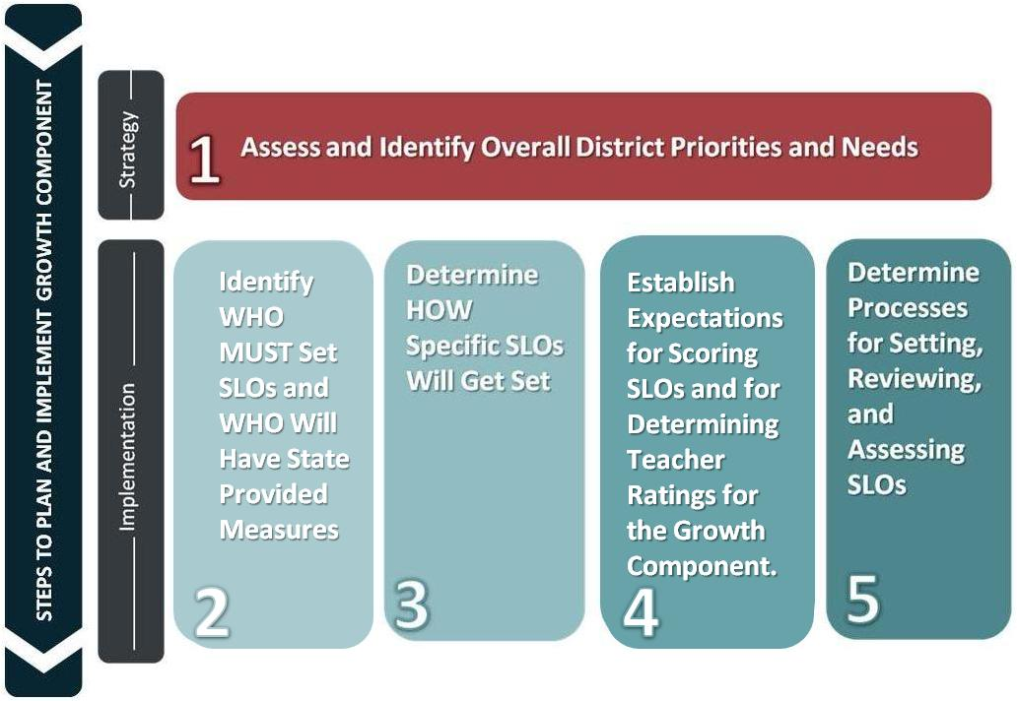
What Does the District Determine?
NYSED Webinar (12.20.11)
Notes:
This slide lays out the steps Districts need to take before schools and teachers can get started with SLOs.
1. Start with your overall district priorities and needs
2. Work through grades/subjects for your teachers and identify who must set SLOs and who will have SLOs
3. Determine how specific SLOS will get set. Specifically, what grades and subjects already have district-wide assessments that you will require be used with SLOs; are there areas where you plan to develop or acquire new assessments; what choices around assessments will you leave to schools?
4. Establish district expectations for scoring SLOs, and for determining teacher ratings for the growth component.
5. Finally, make district decisions about processes for developing, approving, and assessing SLOs. For instance, what timetable will you set for your goal setting/review cycle? How will you ensure consistency and rigor across classrooms (e.g., will the district approve all SLOs, or a sample?); what training and resources will you provide for principals and teachers (norming activities, inter-rater reliability, etc); what data systems can help support the SLO process, and how will you address assessment security?

Slide 18
NYSED Webinar (12.20.11)
Notes:
This slide makes the point about how many of our teachers will have Student Learning Objectives as their growth measures.
Let’s start at the bottom of this bar chart which has been generated using SED class assignment data. Approximately 14% of our teachers are teaching in 4-8 ELA and Math. These teachers will receive growth/VA scores from the state.
Moving up, you see that our data says that 21% of teachers are assigned as teachers of students in Special education, ESL, or bilingual: many are covered by state assessments in the 4-8 ELA/Math group so they will have state-provided growth/VA scores. If not, they will have SLOs.
Continuing, we get to middle and high school ELA, math, science and social studies: our “core subject areas” in the Regulations. Here, dependent on funding, we have plans to add state assessments in:
ELA 9-11 (2012-13)
Science 6-8
Social Studies 6-8
These teachers will all have SLOs in 2012-13.
For all of our other teachers (such as K-3, CTE, phys ed, arts, etc.), SLOs will be used to measure student learning for the State growth component of a teacher’s overall evaluation.

Slide 19
Teachers by Grade and Subject: | Growth is State-provided SGP/VA | Growth is SLO
K-2 Teachers | Future Possibly | 1 SLO for ELA (literacy and writing) 1 SLO for Math (unless teacher focuses on single subject area)
3 Teachers | Future Possibly | 1 SLO for ELA (literacy and writing) 1 SLO for Math (unless teacher focuses on single subject area) (must use State assessment as evidence)
4-8 Common Branch/ ELA/Math Teachers | YES | N/A
4-8 Science and Social Studies Subject Teachers | Future Likely | - 1 SLO for each subject/assessment – (SLOs must cover classes with largest numbers of students until a majority of students are covered) Grades 6-7 Science and 6-8 Social Studies must use a State-approved 3rd party assessment as evidence; Grade 4 and Grade 8 Science must use a State assessment as evidence.
4-8 Other Subject Teachers | NO
9-12 Core Subjects, Regents Subjects and Regents Equivalents | As available | 1 SLO for each subject/assessment - (SLOs must cover classes with largest numbers of students until a majority of students are covered) - Core Subjects: High school ELA, Math, Science and Social Studies courses associated in 2010-11 with Regents or, in the future, with other State assessments must use a State assessment as evidence if one exists (or Regents equivalents). If not, SLO must use assessment from list of State-approved 3rd party assessments and Regents equivalents.
9-12 Other Subject Teachers |  | 1 SLO for each subject/assessment - (SLOs must cover classes with largest numbers of students until a majority of students are covered
Teachers with a Mix of Sections/Courses With/ Without State-Provided Growth Measures | Yes if ≥50%of sections/students are covered by SGP/VA | If <50% covered by SGP/VA, then SLOs will be used. - First, SLOs must use SGP/VA where available; then create SLOs for largest sections without SGP/VA until majority of students are covered.

Slide 20

Who needs SLOs?

Slide 21
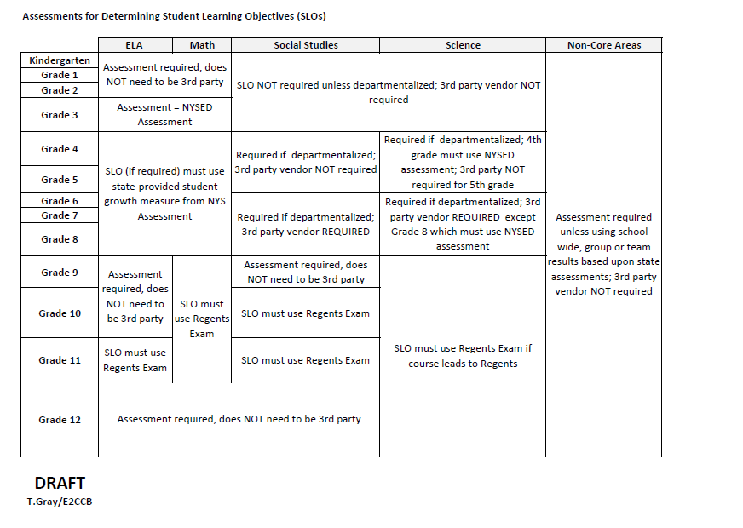

Slide 22
School Wide, Group or Team Measures
School-wide, group, or team measures are an option as a comparable growth measure SLO but they must be based on State assessments.
Provides a means of providing measures of student learning for teachers who do not have a common, district-wide or State assessment that covers their content area.

Slide 23
NYSED Webinar (12.20.11)
Notes:
This slide makes the point about how many of our teachers will have Student Learning Objectives as their growth measures.
Let’s start at the bottom of this bar chart which has been generated using SED class assignment data. Approximately 14% of our teachers are teaching in 4-8 ELA and Math. These teachers will receive growth/VA scores from the state.
Moving up, you see that our data says that 21% of teachers are assigned as teachers of students in Special education, ESL, or bilingual: many are covered by state assessments in the 4-8 ELA/Math group so they will have state-provided growth/VA scores. If not, they will have SLOs.
Continuing, we get to middle and high school ELA, math, science and social studies: our “core subject areas” in the Regulations. Here, dependent on funding, we have plans to add state assessments in:
ELA 9-11 (2012-13)
Science 6-8
Social Studies 6-8
These teachers will all have SLOs in 2012-13.
For all of our other teachers (such as K-3, CTE, phys ed, arts, etc.), SLOs will be used to measure student learning for the State growth component of a teacher’s overall evaluation.

Slide 24

School Wide, Group or Team Measures
SLO based on school-wide growth on the State ELA tests as a measure of student growth for all arts teachers within a district since growth in the various arts is difficult to measure and ELA skills could be enhanced by course work in the arts.
In this case, all arts teachers in a school would earn the same score for the growth component of their evaluations.

Slide 25

School Wide, Group or Team Measures
A district may decide to measure all elementary school push-in and pull-out teachers on school-wide growth on ELA and/or Math because the districts believes it will help promote collaboration, and it is difficult at this point to determine their individual contribution to specific students’ growth.

Slide 26
Questions
Email questions and requests for information at anytime to:
slohelp@mail.nysed.gov

