Slide 1
Social and Emotional Developmental Health
Resources through the lens of the DTSDE Statements of Practice
Ann Maguire and Linda Finn

Slide 2
Why this Focus for schools in need of improvement?
Current national research on impact and specifics
for best practice, including on Social and Emotional Learning (SEL)

Slide 3
Current Structure of DTSDE Rubric
Six tenets
Overarching statements
Statements of practice for each element of the rubric (aka SOP)
Sub-statements of practice for each SOP
Every sub-statement of practice includes references to planning, implementation and reviewing/reassessing efforts.

Slide 4
Digging into DTSDE Tenet 5 in Detail
Circle the details that look to be different from your current definition of best practices.
Underline the ones that confirm what you are already doing in your district.
Highlight the ones you question.

Slide 5
Major Shifts embedded in Tenet 5
Proactive vs. reactive approach focusing on all students and all stakeholders
All stakeholders own the outcomes.
School leaders allocate curriculum resources and instructional time for deliberate instruction to support student learning about SEL.

Slide 6
Social and Emotional Health
Resources

Slide 7
5.2: The school cultivates the development of overarching systems and partnerships that support and sustain social and emotional developmental health.

Slide 8
a) A deliberate system has been established that allows each child to be well-known by a designated adult who coordinates social and emotional health needs in a system that positively reinforces academic success for all students.
Professional development around relationships
Making students feel connected-ample opportunity
Index card/student names/stickers activity for teachers
Being aware of student affinities and using them to leverage learning

Slide 9
b) There is a strategic and comprehensive system for referral and support for all students t hat effectively addresses barriers to social and emotional developmental health and academic success.
Masonic Model (MSAT) addresses: high risk behavior, depression/suicide, children from families in pain, enabling, life skills, effective communication
http://www.nymasons.org/index.php?option=com_content&view=article&id=39:masonic-student-assistance-training-program-msat&catid=18
Crisis Intervention Teams
Role of Guidance Counselor/Social Worker
40 Developmental Assets

Slide 10
c. The school strategically uses data to identify areas of need and leverages internal or external resources and cultivates partnerships that strongly impact the social and emotional developmental health of students.
40 Developmental Assets
Tapestry/DOH Resources
Mental Health Testing

Slide 11
5.3 The school articulates and systemically promotes a vision for social and emotional developmental health that is connected to learning experiences and results in building a safer and healthier environment for families, teachers, and students.

Slide 12
a) All school constituents can articulate a shared understanding of skills and behaviors that demonstrate social and emotional developmental health and how these behaviors are linked and lead to academic success.
Professional Development
Coordinated School Health Model
Whole Child (ASCD)

Slide 13
b) There is a rigorous and coherent curriculum/program in place that teaches, supports, and measures social and emotional developmental health for students that results in all students demonstrating these skills and a sense of belonging and ownership in the school community.
Michigan Model
Second Step
Olweus
Character Ed.
MS/HS Health

Slide 14
c) There is a deliberate professional development plan that builds adult capacity to facilitate learning experiences and to support social and emotional developmental health for all students, resulting in a safe and healthy environment that is conducive to learning across the school community and impacts student academic success.
DASA Training
SAVE Training
Collaboration between IES and CSH to provide quality professional development
Michigan Model Teacher Training
Guidance Document Training (Health Ed.)

Slide 15
5.4: All school constituents are able to articulate how the school community is safe, conducive to learning, and fosters a sense of ownership that leads to greater student outcomes.

Slide 16
a) Across the school community, students are able to express that they feel safe, supported in their social and emotional developmental growth, and have a voice in decisions that impact their lives as students (as developmentally appropriate).
Student Surveys (School Climate)
Student representation on major decision making committees.
“Don’t make decisions about us, without us.”

Slide 17
b) Across the school community, teachers articulate their investment in the school vision and how they have a voice in decisions that impact the school environment and student learning.
Shared decision making
Voice in PD opportunities
Voice in curriculum/outside programming

Slide 18
c) Across the school community, parents are able to express how their children have demonstrated growth as a result of the school’s social and emotional developmental health support and how this support is tied to the school’s vision and students’ needs.
Looking at report cards-Are students given comments on or graded on SEL skills?
Opportunities for parent engagement (Tenet 6)

Slide 19
5.5: The school leader and student support staff work together to develop teachers’ ability to use data to respond to students’ social and emotional developmental health needs so students can become academically and socially successful.
Professional Development!

Slide 20
Putting all the pieces together

Slide 21
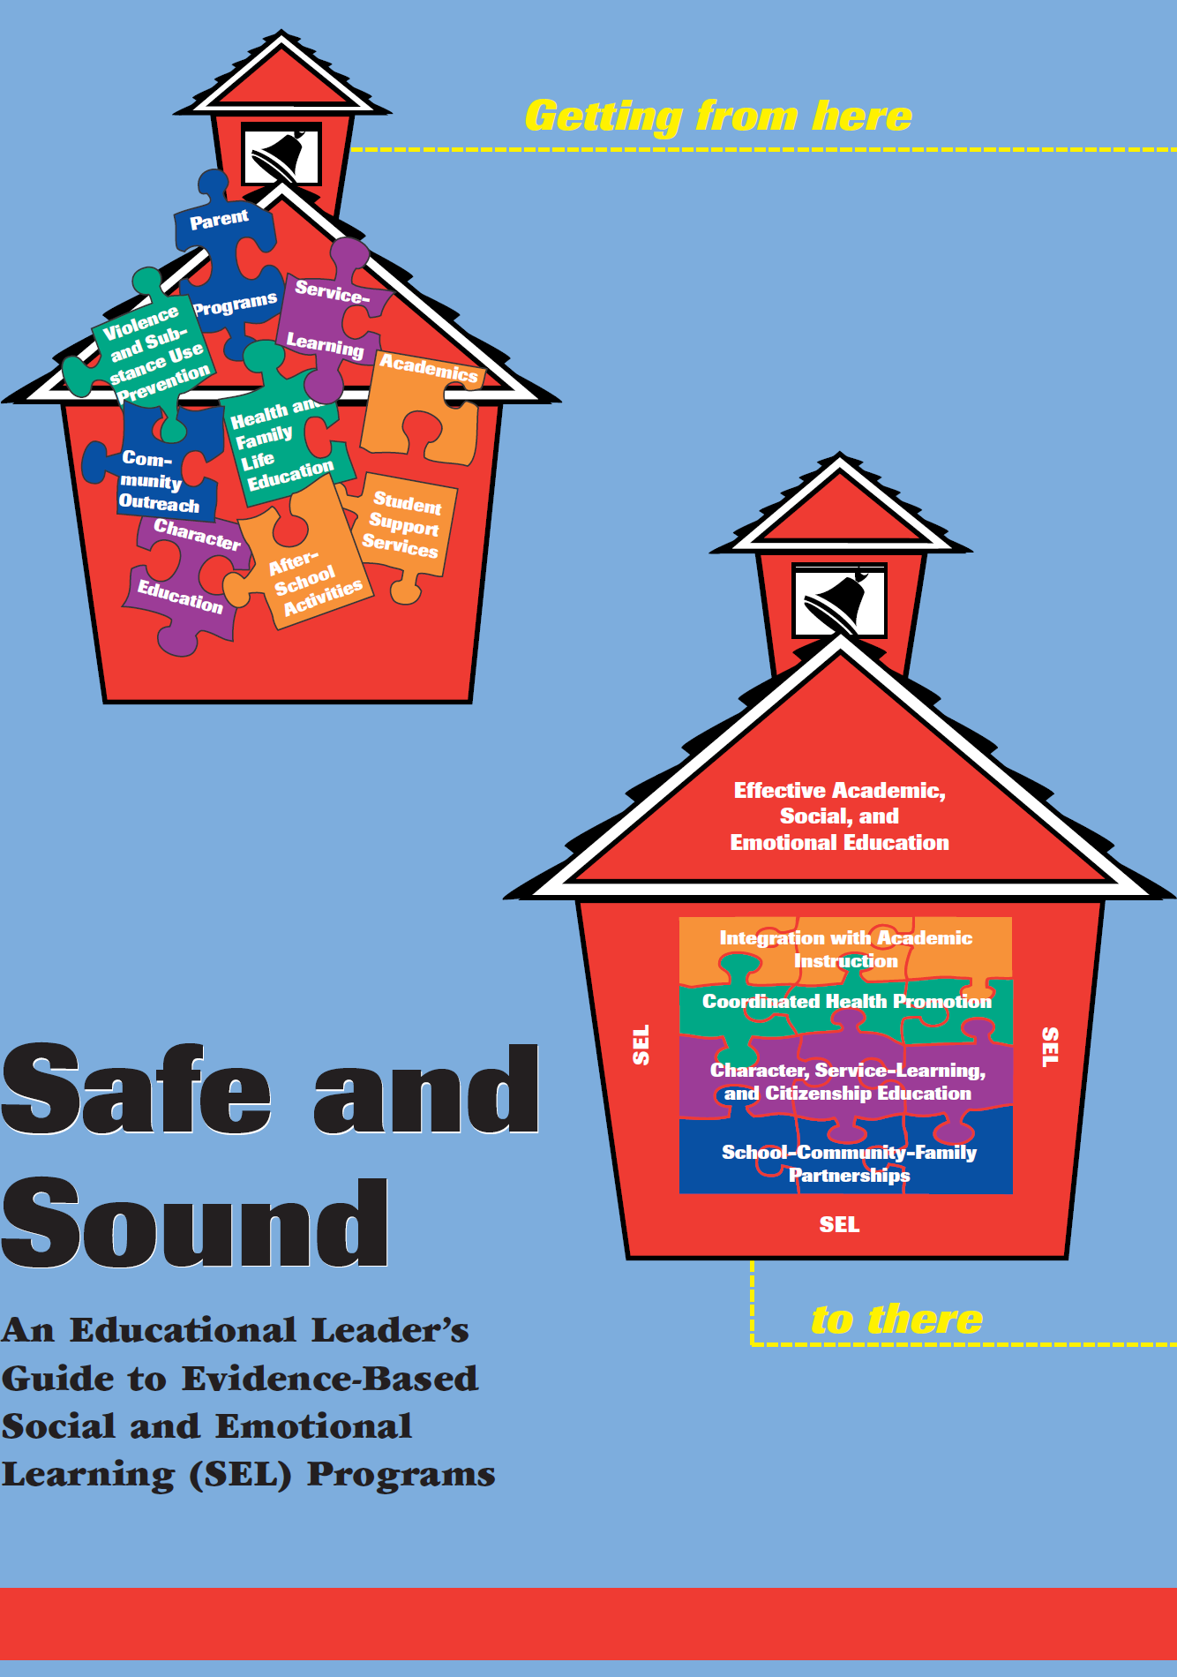

Slide 22
Coordinated School Health

Slide 23
Michigan Model
Social and Emotional Health Topics
Showing respect and caring
Appreciating and respecting individual differences
Making and keeping positive friends
Identifying and managing emotions
Protecting self and others from bullying
Solving problems and making decisions
Communicating effectively and interacting appropriately
Helping others
Knowing when and how to get help from trusted adults
Resolving conflicts non-violently
Setting goals
Advocating for positive behavior
Managing stress

Slide 24
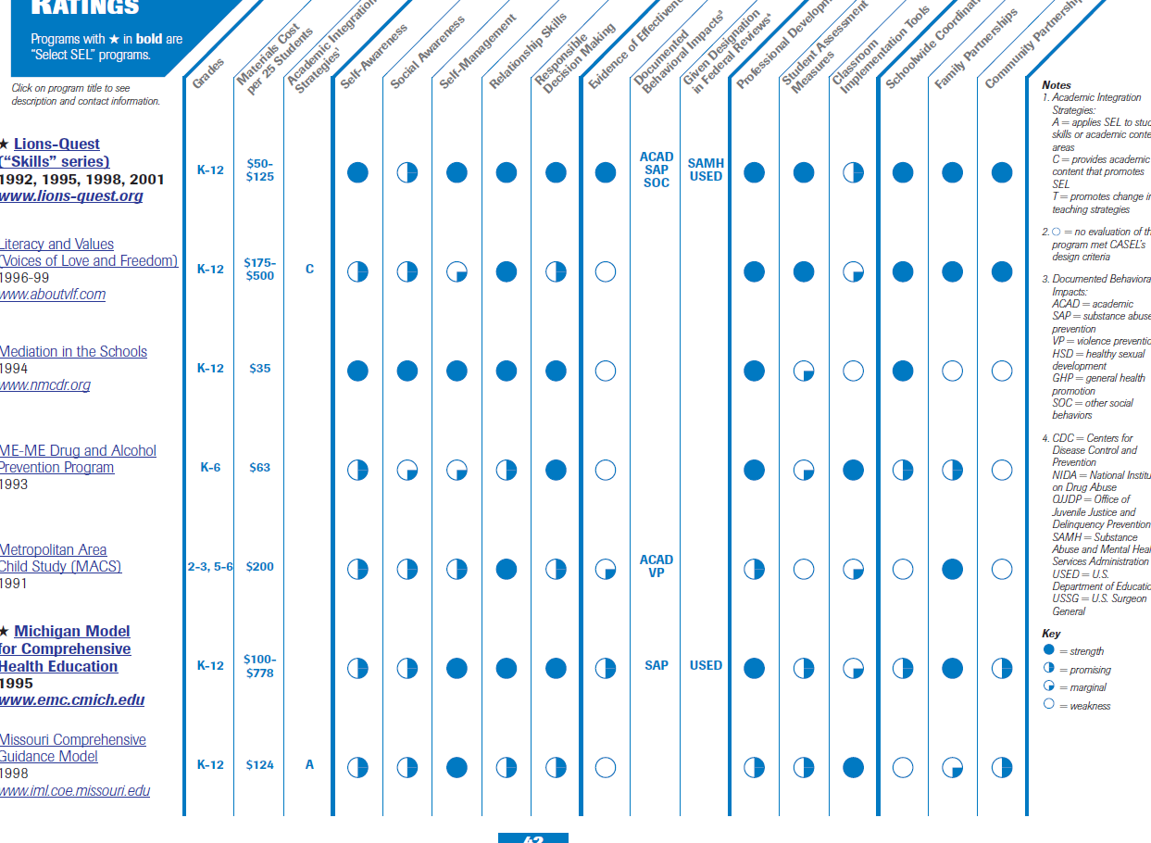

Slide 25
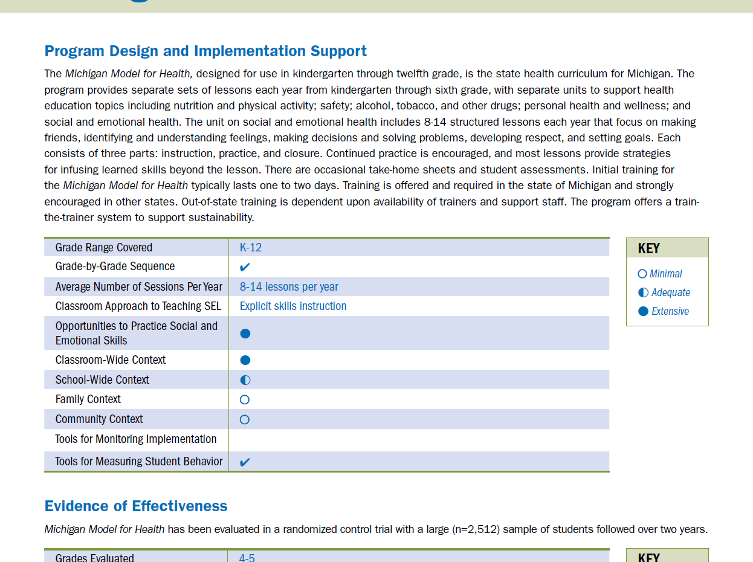

Slide 27
Resources
Safe and Sound: An Educational Leaders Guide to Evidence-Based Social and Emotional Learning Programs, Collaborative for Academic, Social and Emotional Learning (CASEL, 2003).
Payton, J., Weissberg, R.P., Durlak, J.A., Dymnicki, A.B., Taylor, R.D., Schellinger, K.B., & Pachan, M. (2008).The positive impact of social and emotional learning for kindergarten to eighth-grade students: Findings from three scientific reviews. Chicago, IL: Collaborative for Academic, Social, and Emotional Learning.
Collaborative for Academic, Social, and Emotional Learning (CASEL), 2005; Elias, Zins, Weissberg, Frey, Greenberg, Haynes, Kessler, Schwab-Stone, & Shriver, 1997; Zins & Elias, 2006. http://www.CASEL.org.
Durlak, J.A. Weissberg, R.P., Dymnicki, A.B., Taylor, B.D., & Schellinger, K.B. The impact of enhancing students’ social and emotional learning: A meta-analysis of school-based universal interventions (2010).
Connecting Social Emotional Learning with Mental Health. National Center for Mental Health Promotion and Youth Violence Prevention by the Collaborative for Academic, Social, and Emotional Learning at the University of Illinois at Chicago. January 2008.

