Slide 1



New York State Reform Agenda
NYSCOSS
September 26, 2011
Notes:
1
KEN

Slide 2
Animating the Reform Agenda
Investing in human capital, supporting with critical tools
Adopting internationally-benchmarked standards and assessments that prepare students for success in college and the workplace
Building instructional data systems that measure student success and inform teachers and principals how they can improve their practice
Recruiting, developing, retaining, and rewarding effective teachers and principals
Turning around the lowest-achieving schools
Highly Effective
School Leaders
Teacher Evaluation
Statewide Standards-based Curriculum
Assessment Data
Highly Effective
Teachers
College and Career Ready Students
Notes:
KEN: OVERVIEW OF REFORM AGENDA
Q. John, we are here to talk about teacher and principal effectiveness and the plans for the NYS reform agenda. So, let’s take a look at this slide [Show Slide 3] can you tell me, John, how does TLE fit into the Regents reform agenda for the State of New York?
A. I think everyone in this room, and everyone watching this, would agree that there is nothing more important to our children getting a first-rate education than the teachers and principals that we put in our buildings. Great educators have the ability to influence a student’s academic growth , and even more importantly – to fundamentally change the trajectory of a child’s life – in a way that goes beyond a child’s socioeconomic status or family background. So, we know that talent matters tremendously.
Through RTTT, we have created a Reform Agenda with comprehensive plans to reform our schools, and we did so through demonstrated courage and commitment from a diverse group of stakeholders all of whom wanted to ensure our practices would improve outcomes for all of our students. We set an incredibly high bar for success, and we made commitments to raise our standards, to use data to help our teachers and school leaders accelerate student achievement, to overhaul our teacher and principal evaluation systems and to focus on recruitment, development, retention, and rewards for effective teachers and leaders. We committed to turning around our struggling schools, because we all believe that we must drastically improve education quality for our students, so we must now transform our lowest-achieving schools into centers of excellence with effective leaders at the helm of every school, and effective educators in every classroom.
Our RTTT plan was innovative and reflective of our commitment to embrace real and meaningful change within our overall Regents reform agenda. Our RTTT plan helped lay the groundwork for this agenda, but our new laws do not just apply for those participating in RTTT; rather, the new laws apply to all districts and BOCES across the State who are now required to implement as well.

Slide 3
Data System: Priority Initiatives
Student-Teacher Linkages
P-20 Data System
Higher Education System Enhancements
Instructional Support System
Notes:
KEN
3

Slide 4

Great Teachers and Leaders
Common
Core
Data Driven
Instruction
Educator
Standards
of Practice
Focus on
High-Need
Schools and
Districts
Prepare
Develop/Assess
Retain
Monitor and
Improve
Frameworks for managing human capital in schools: see for example: Rachel E. Curtis, Teaching Talent: A visionary Framework for Human Capital in Education, Harvard Education Press, Chapter 9; Herbert Heneman and Anthony Milanowski, Assessing Human Resource Alignment: The Foundation for Building Total Teacher Quality Improvement.
1
Notes:
KEN
[Main point: building out a continuum of supports, beginning with preparation and continuing through development and retention/advancement with CCSS, DDI, Educator Standards and a focus on addressing teacher shortages, particularly in high-need schools/districts infused throughout. We have initiatives at each point along this continuum. We are particularly focused on preparing teachers to teach in shortage areas.]
It’s all about starting from the beginning, as this graphic shows, in educator prep programs with the objective of building a workforce that can advance student achievement. The same skills and competencies (our educator standards and for us Common Core and Data Driven Instruction) must infuse initiatives from preparation through development and retention/advancement. Performance evaluation—provides the standards and the measurements to target each initiative appropriately and to continuously improve.
A number of writers about education have zeroed in on the importance of a comprehensive and coherent approach to improving teacher and leader effectiveness—two are cited here. Our Rt3 initiatives will help push our state and districts in this direction. Today we’ll talk about how.
We are focusing on preparing educators across the state to teach in shortage areas, in high needs schools and districts. In this next slide you will see some of the human capital challenges we are currently facing.
4

Slide 5





NYS Common Core Standards and Assessments
Rigorous
Standards
and
Assessments
Pre-K to 12
NY Graduates
are College
and Career
Ready
NY HS Grads
Have Skills to Enroll in and Pass
Credit-bearing Courses in 1st Semester and/or Embark on Careers
5
1
Notes:
KRISTEN: Theory of action for Standards and Assessments
5

Slide 6
Theory of Change
Common Core
Data Driven Instruction
Effective Teachers and Leaders
High Quality Turnkey Training
Impactful Job Embedded Support
Effective Practice in Schools
Culture
Messaging
Institutes
Video
Tools
Exemplars
DRAMATIC INCREASES IN STUDENT ACHIEVEMENT
Highly Trained Network Teams
& Informed Leaders

Slide 7

NYS Common Core Implementation
2
2
Notes:
KEN: Overview of standards / curr / network teams. Do not go too deep into shifts, as David and I will do.

Slide 8
NYS Common Core Implementation
Authors of the Common Core Standards have identified . . .
6 Shifts in ELA/Literacy
6 Shifts in Mathematics
Balancing Informational and Literary Text
Building Knowledge in the Disciplines
Staircase of Complexity
Text-based Answers
Writing from Sources
Academic Vocabulary
Focus
Coherence
Fluency
Deep Understanding
Applications
Dual Intensity
NYS Common Core Implementation
Tools for Implementation
Summer 2011–SY 2011-12 | ELA and Math Curriculum Modules Sample Modules Network Teams Summer Institute EngageNY Mircosite 6 Exemplary CCSS Models
Summer 2012–SY 2012-13 | 50% of ELA and Math Exemplary Models Additional CCSS training Training on Assessments Transition 3-8 ELA & Math/Algebra exams CCSS aligned
Summer 2013–SY 2013-14 | Full menu of ELA and Math exemplary units Full CCSS implementation in schools Geometry exam aligned
Summer 2014–SY 2014-15 | Ongoing training on CCSS implementation Training on PARCC assessments (if adopted) Full implementation of CCSS & PARCC (if adopted)
Exemplary Modules
Publishers Criteria
Alignment Rubric for Curricular Materials
Turn-key Materials from Network Team Summer Institute
PBS Videos with School Action Guide:
  6 Shifts in Math; 6 Shifts in ELA/Literacy
  Close reading of MLK
  Teachers diving into content
  What matters in CCSS implementation
2
2
Notes:
KEN: Overview of standards / curr / network teams. Do not go too deep into shifts, as David and I will do.

Slide 9
Delivery System: State Regional Local
DATA
SCHOOLS
BOCES &
Big 5 Districts/
Network Teams
NYSED
LEAs
PARTNERS
Align RTTT with Regents policies
Coordinate services
Track outcomes
Implement educator- and classroom-level reforms via Inquiry Teams
Deliver professional development
BOCES District Superintendents represent the Commissioner in the field
Align local instruction
Use data
Participate in professional development
Conduct evaluations
Develop content for professional development
Support school improvement
3
Notes:
9
KEN
The Commissioner will likely discuss the APM’s this evening, but I want to discuss them briefly so as to give a sense of the reform agenda, where we are and where we are headed in terms of readiness. As far as the space between, we need to have news structures, tools and resources in place. For our purposes this morning, those tools and resources are being delivered by a mechanism created in the RTTT app – the Network Teams. While modeled on a concept from NYC, we took the best of the model for our design as there are segments in NYC that simply aren't up to par with the design. The network teams are…describe…. And will be trained…. Describe.
Our big bet is on the turnkey training which does not historically have a high transfer rate that maintains fidelity.

Slide 10
Assessments: Criteria for College and Career Readiness
Rigorous
Standards
Ongoing &
Comprehensive
Validation
Assessment
Design
“On-track”
Cut Scores
Notes:
DAVID
TALKING POINTS
To ensure that New York State assessments in ELA, Math, Science, and Social Studies/History are aligned to college and career readiness requires:
(1) a robust set of standards that articulate the knowledge and skills that students need to be on track to college and career readiness in each subject area;
(2) an assessment design that measures these knowledge and skills with fidelity (e.g., through rich performance tasks and innovative items);
(3) setting performance standards using contemporary best practice that integrates professional judgment and empirical data; and
(4) a robust, comprehensive and ongoing validation strategy to ensure scores from assessments are supporting appropriate inferences about student performance AND THIS INCLUDES METHODS TO ESTABLISH TEST INTEGRITY THROUGH ERASURE ANALYSIS THAT YOU HAVE HEARD US DISCUSSING RECENTLY (IF QUESTIONS COME UP ABOUT THE NYT STORY, KEN WILL TAKE THOSE)

Slide 11
NEW YORK STATE TESTS WILL BEGIN TO INTEGRATE COMMON CORE IN 2012-13 and 2013-14
Starting in 2012-13:
  test formats will remain similar to 2011-12
  but content will begin to align to Common Core
In ELA/Literacy, assessments will include more informational text
In Math, assessments will focus on prioritized standards
11
Notes:
DAVID

Slide 12
ELA/LITERACY ShIFTS IN TEACHING AND ASSESSMENT
Balancing Informational & Literary Texts - Passages will be authentic and balanced across informational and literary
Knowledge in the Content Areas - Assessment will contain knowledge-based questions about the informational text; students will not need outside knowledge to respond
Grade-level Text Complexity - Passage selection will be based on text complexity that is appropriate to grade level per Common Core
Text-based Answers & Writing from Sources - Questions will require students to marshal evidence from the text, including from paired passages
Academic Vocabulary - Students will be tested directly on the meaning of pivotal, common terms from which the definition can be discerned from the text. Academic vocabulary will also be tested indirectly through general comprehension of the text.
12
Notes:
DAVID

Slide 13
MATH SHIFTS IN TEACHING AND ASSESSMENT
Focus - Priority standards will be the focus of the assessments. Other standards will be deemphasized.
Coherence - Assessments will reflect the progression of content and concepts as depicted in the standards across grade levels.
Fluency - It will be assumed that students possess the required fluencies as articulated through grade 8; as such, there will be no calculators in early grades.
Deep understanding - Each standard will be assessed from multiple perspectives while not veering from the primary target of measurement for the standard.
Application and Dual Intensity - Students will be expected to know grade-level math content with fluency and to know which math concepts to employ to solve real-world math problems.
13
Notes:
KRISTEN

Slide 14
NYS Common Core Standards and Assessments
Rigorous
Standards
and
Assessments
Pre-K to 12
NY Graduates
are College
and Career
Ready
NY HS Grads
Have Skills to Enroll in and Pass
Credit-bearing Courses in 1st Semester and/or Embark on Careers
14
1
Notes:
KRISTEN: Theory of action for Standards and Assessments
14

Slide 15
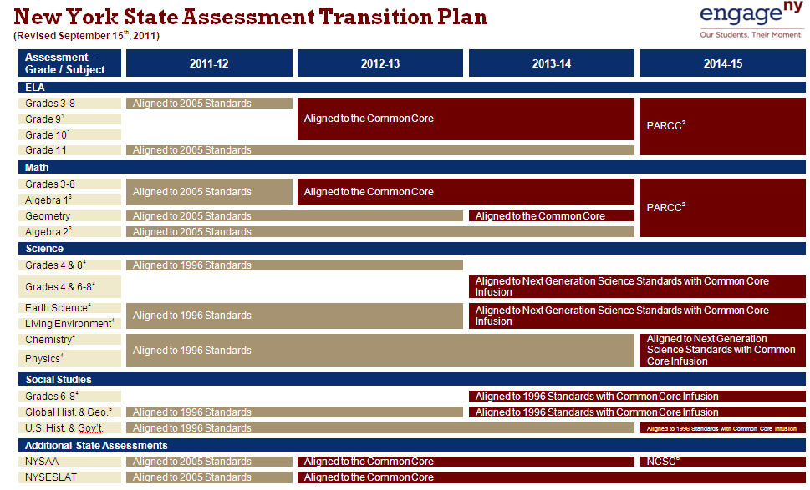
Notes:
KRISTEN
TODAY: Focus on what it means in ELA and Math to be aligned to Common Core, and PARCC.

Slide 16
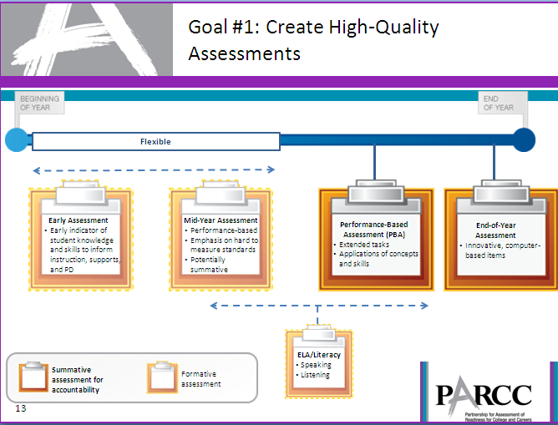
Notes:
KRISTEN

Slide 17

www.engageny.org
www.parcconline.org
Notes:
KRISTEN

