Slide 1
Regional Curriculum Council
October 2014

Slide 2
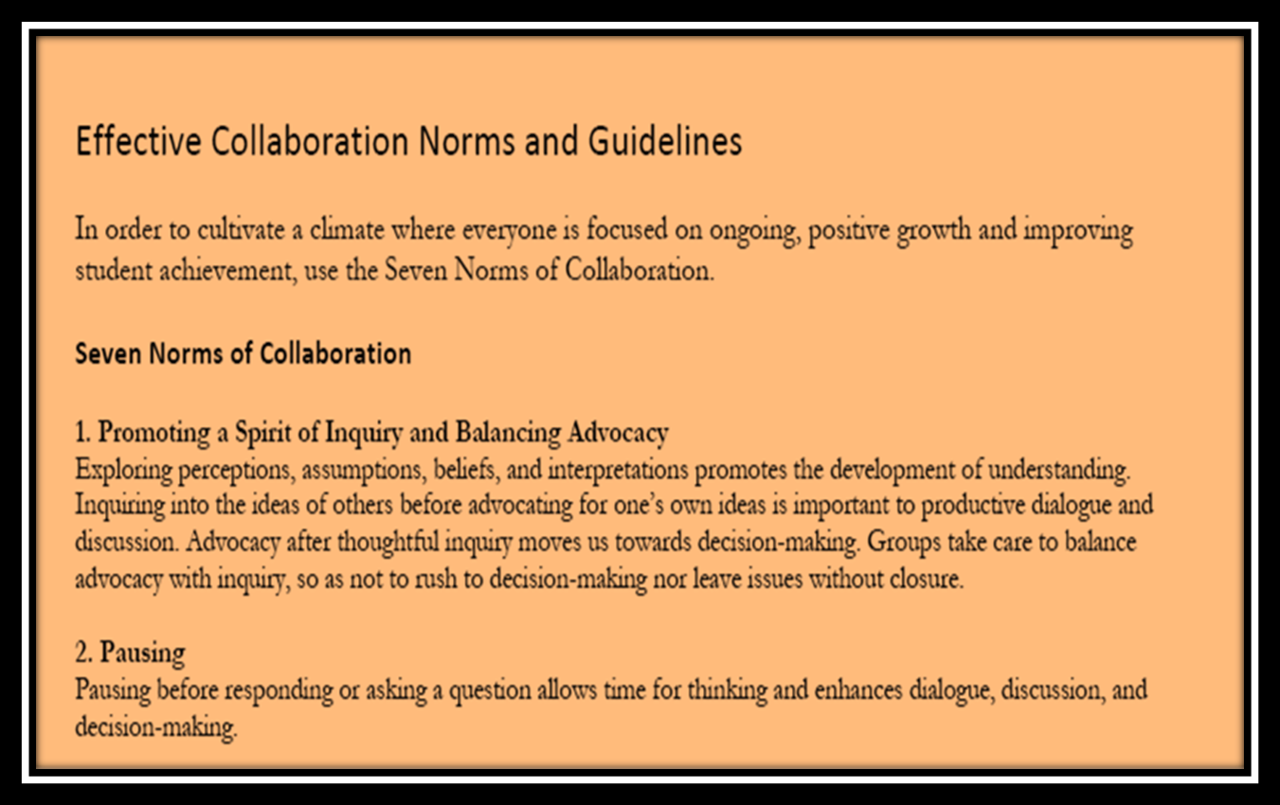
Norms for Collaboration

Slide 3
Focus Norms
Promoting a Spirit of Inquiry
Putting ideas, data, perceptions on the table (and pulling them off)
Paying attention to self and others to monitor our ways of working.
Presuming positive intentions to support a non-judgmental atmosphere.

Slide 4
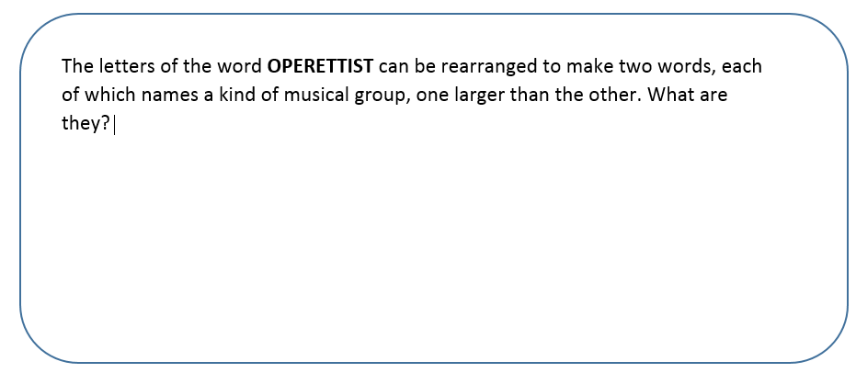
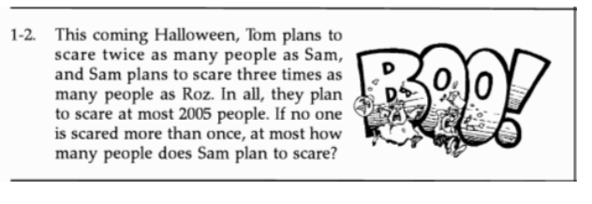
Exploring Growth Mindset

Slide 5
What role does professional learning have on student achievement?

Slide 6
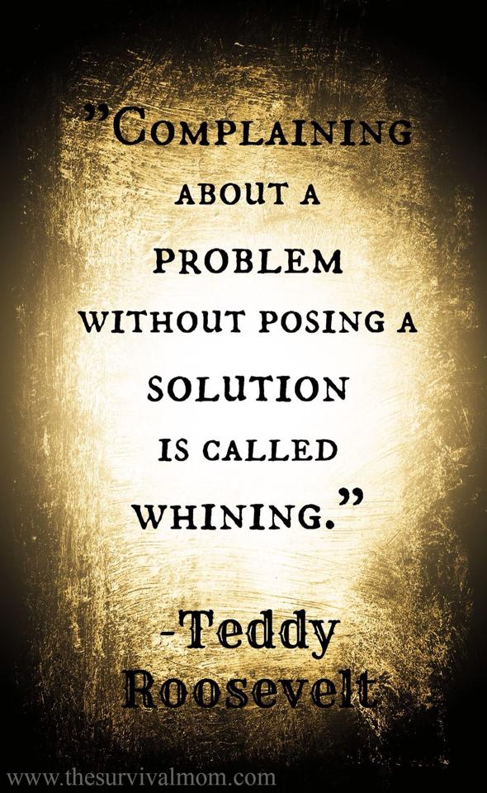

Slide 7
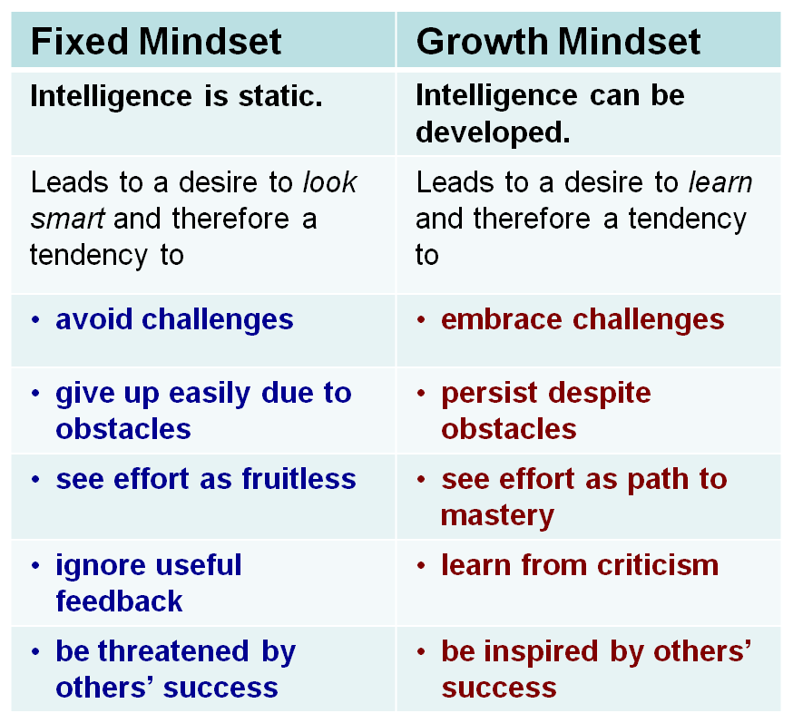

Slide 8
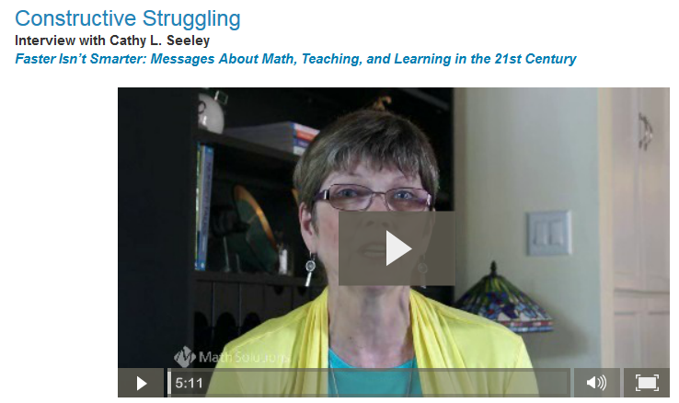
Constructive Struggle

Slide 9
Turn and Talk
What struck you as you watched the short video clip?
How can we create a culture where “constructive struggle” is accepted? Encouraged?

Slide 10
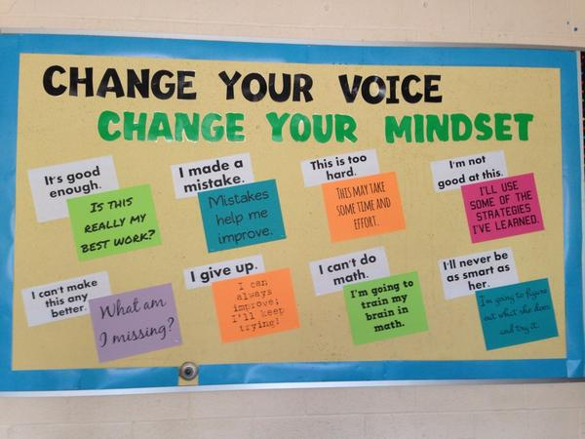

Slide 11

Your words……..

Slide 12
October 2014 Board of Regents Updates
ELA Regents Examination
Art Standards
Science Standards
Social Studies: Regents and Link to Pathways

Slide 14
Career Pathways and PARCC Update
Jennifer Sattem, Regents Research Fellow
Jsattem@mail.nysed.gov

Slide 15
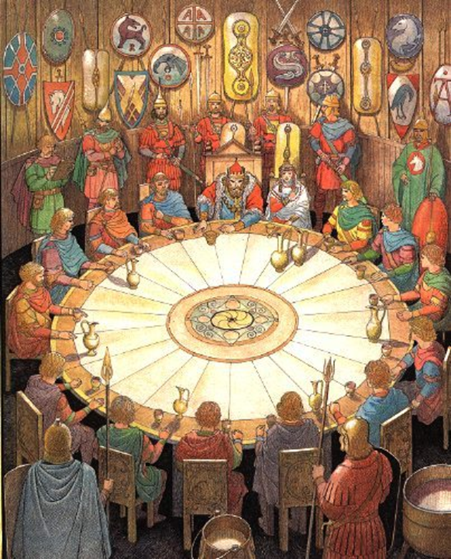
Questions
Bright Spots
District Goals
District Round-Table

