Slide 1

Overview of ELA and Math
Model Content Frameworks

Slide 10

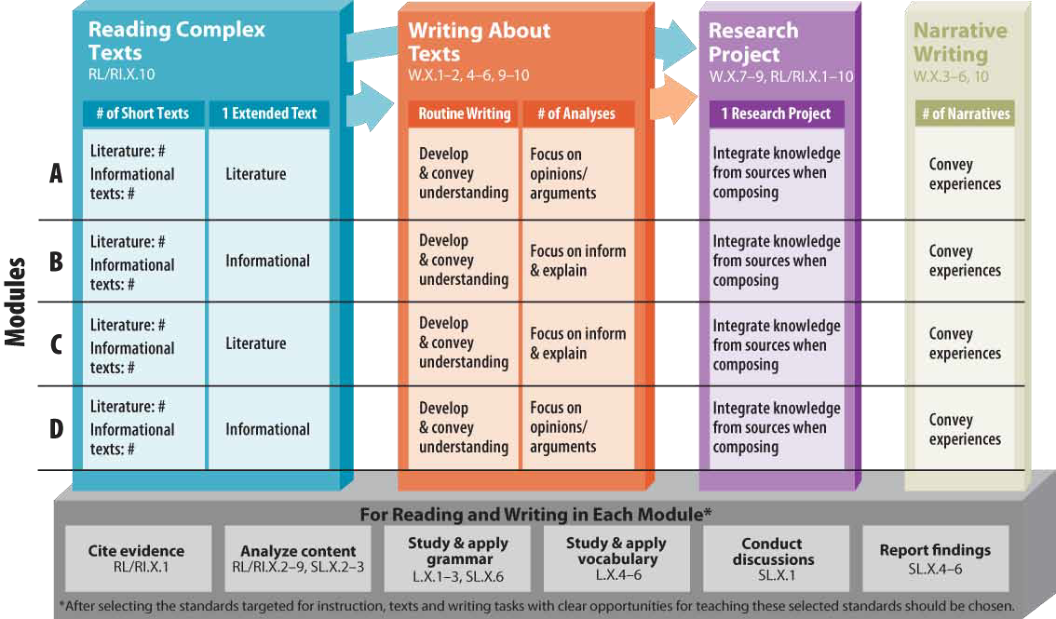
Model Frameworks for ELA: Consider the graphic itself, the text in the graphic, the implications of each of these for instructional design and shifts in instructional strategies.

Slide 11
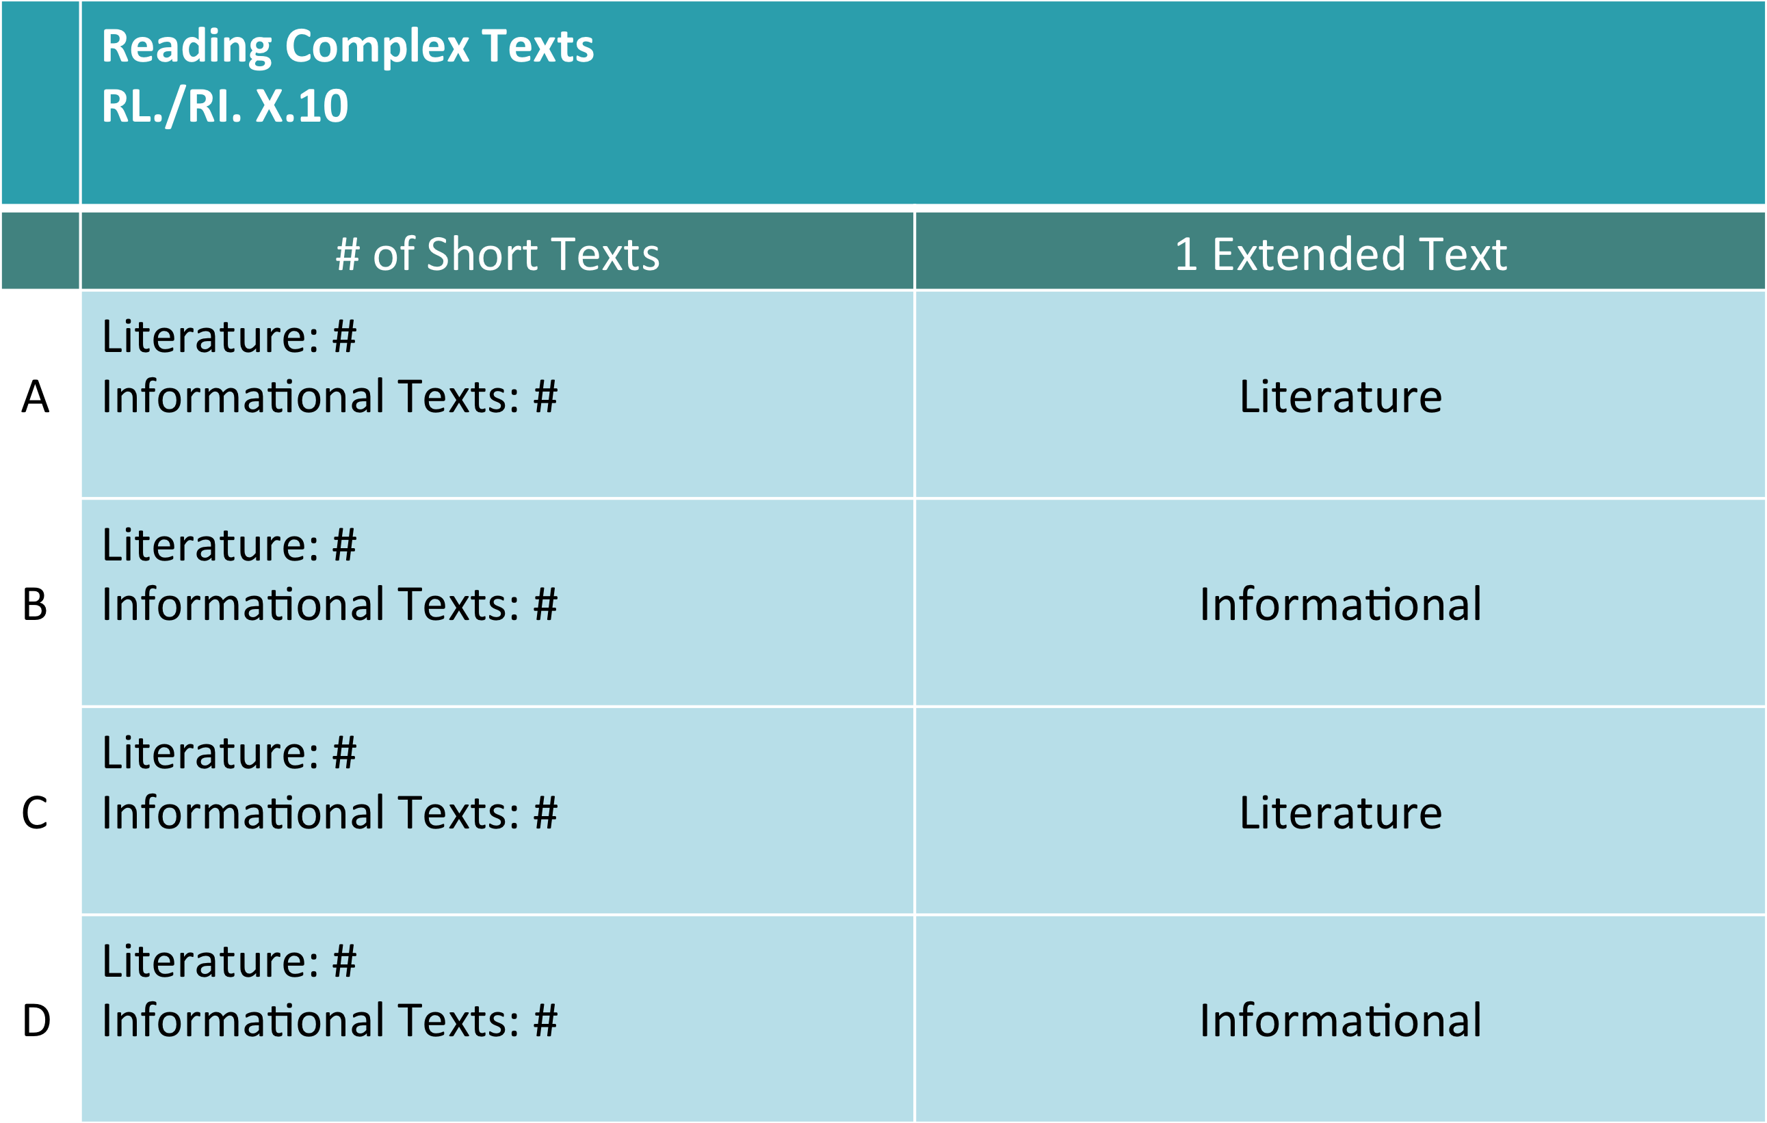
Reading Complex Texts
Notes:
The four modules (A, B, C, D), each contain one extended work and several short texts.
The four extended works are split equally—two literature texts and two informational texts. Discuss implications.
The number and type of texts change as students progress through the grade levels.
Discuss the implications of the arrows—that writing and research are tied to reading complex texts.

Slide 12
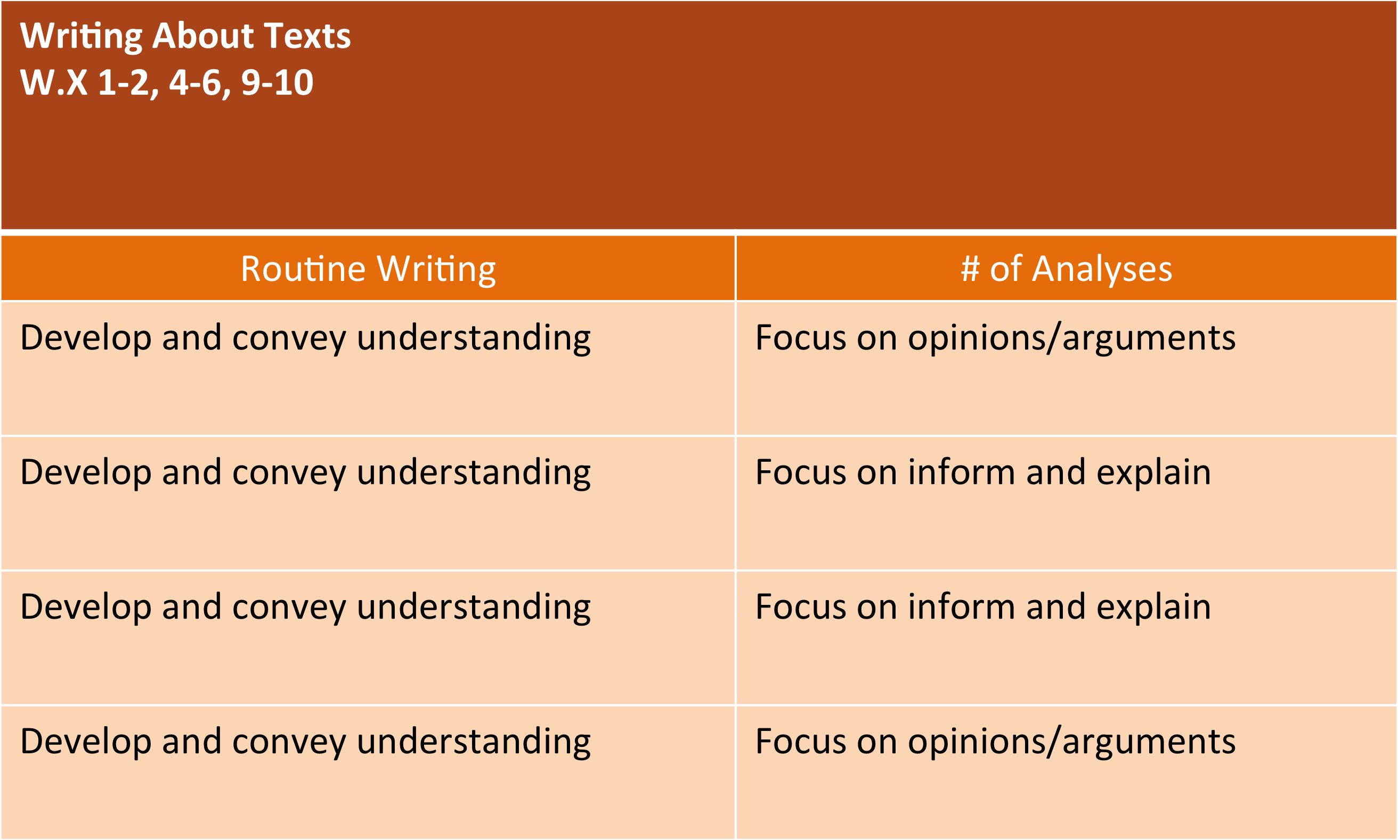
Writing About Texts
Notes:
What are the implications of the title—writing about texts?
Routine writing to develop understanding—writing is intended as a learning tool, not just as an assessment.
Two types of analytical writing:
opinions/arguments
inform/explain (included analysis)
The focus of analytical writing is using evidence.
The length of writing assignment may vary from text-dependent short answer questions to multi-paragraph papers.
Implications of the arrows—comes from reading—ideas or synthesis—translates into research
Consistent, routine writing should be part of instructional planning.

Slide 13
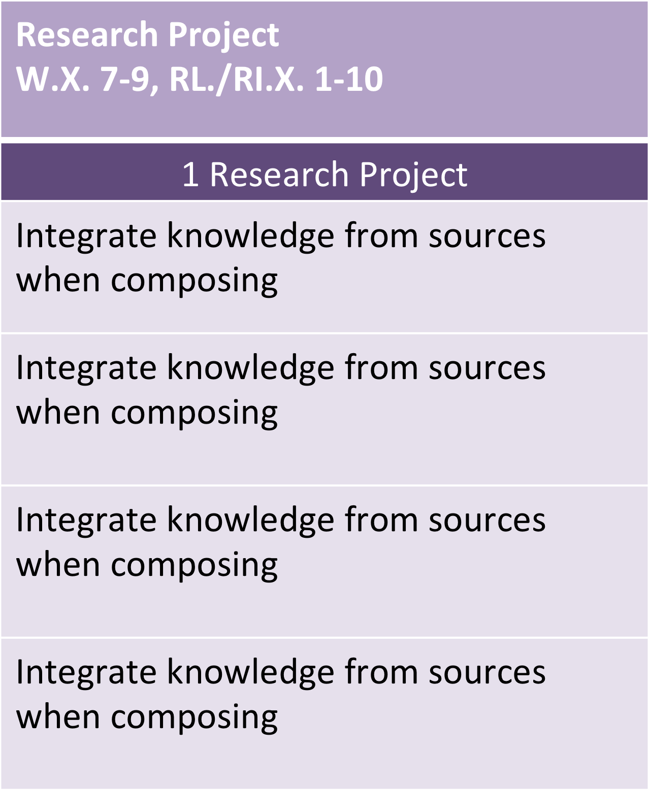
Research Project
Notes:
One research project for EACH module—can be short, focused or a longer, extended project
Reading, writing, language, and speaking and listening (reporting) can all be addressed through the research element.
Integration of knowledge is the focus.

Slide 14
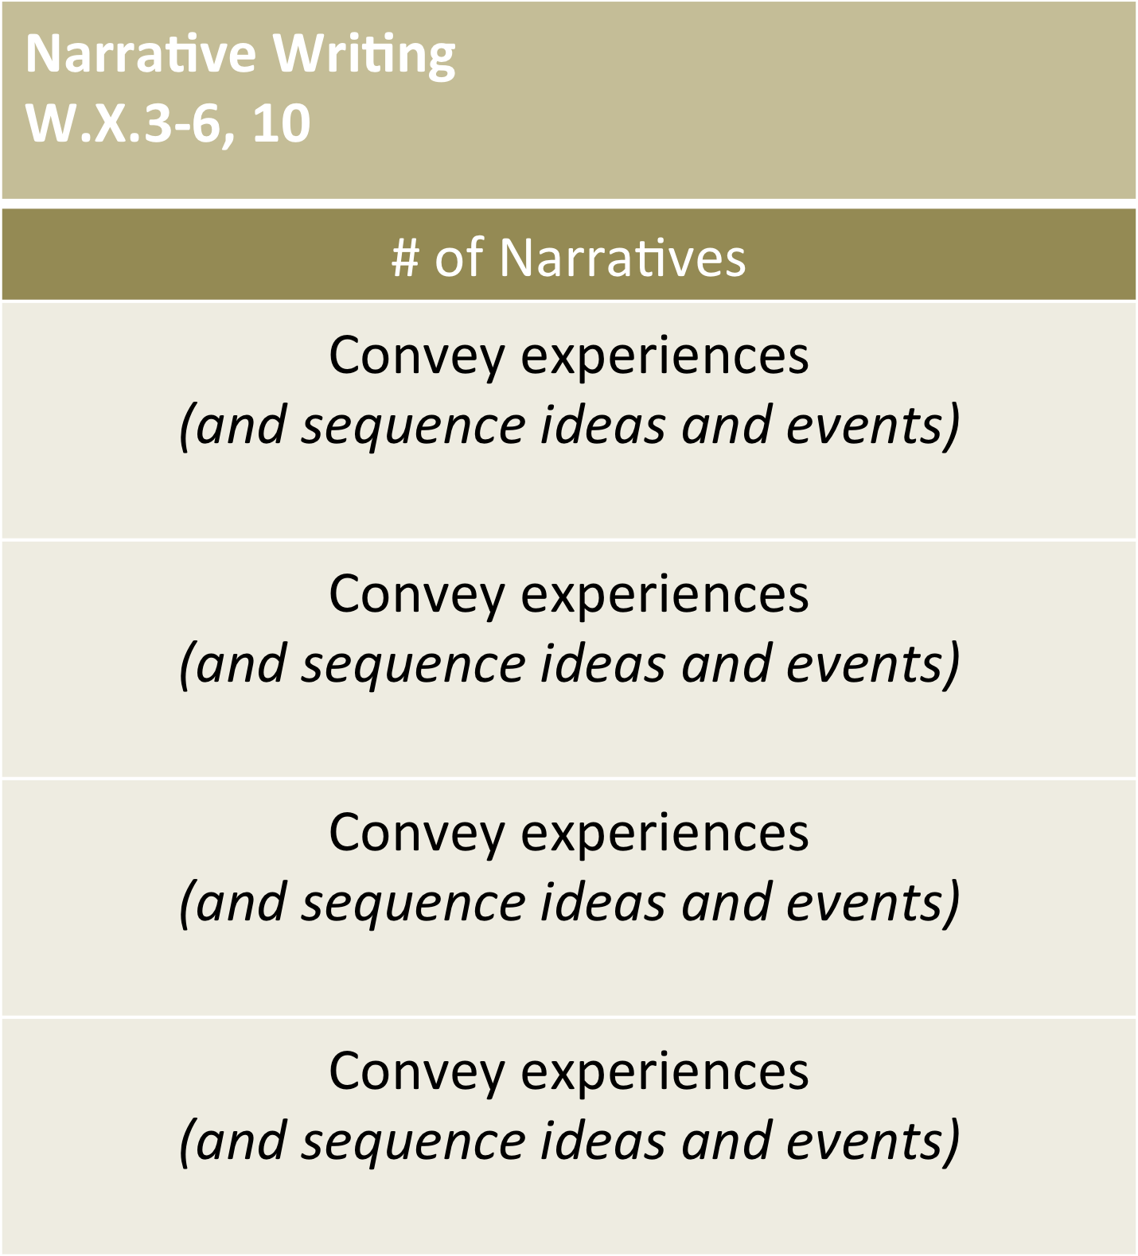
Narrative Writing
Notes:
A set number of narrative writing assignments per module (number decreases through grade levels).
Purpose is to convey experience and can be tied to reading.

Slide 15
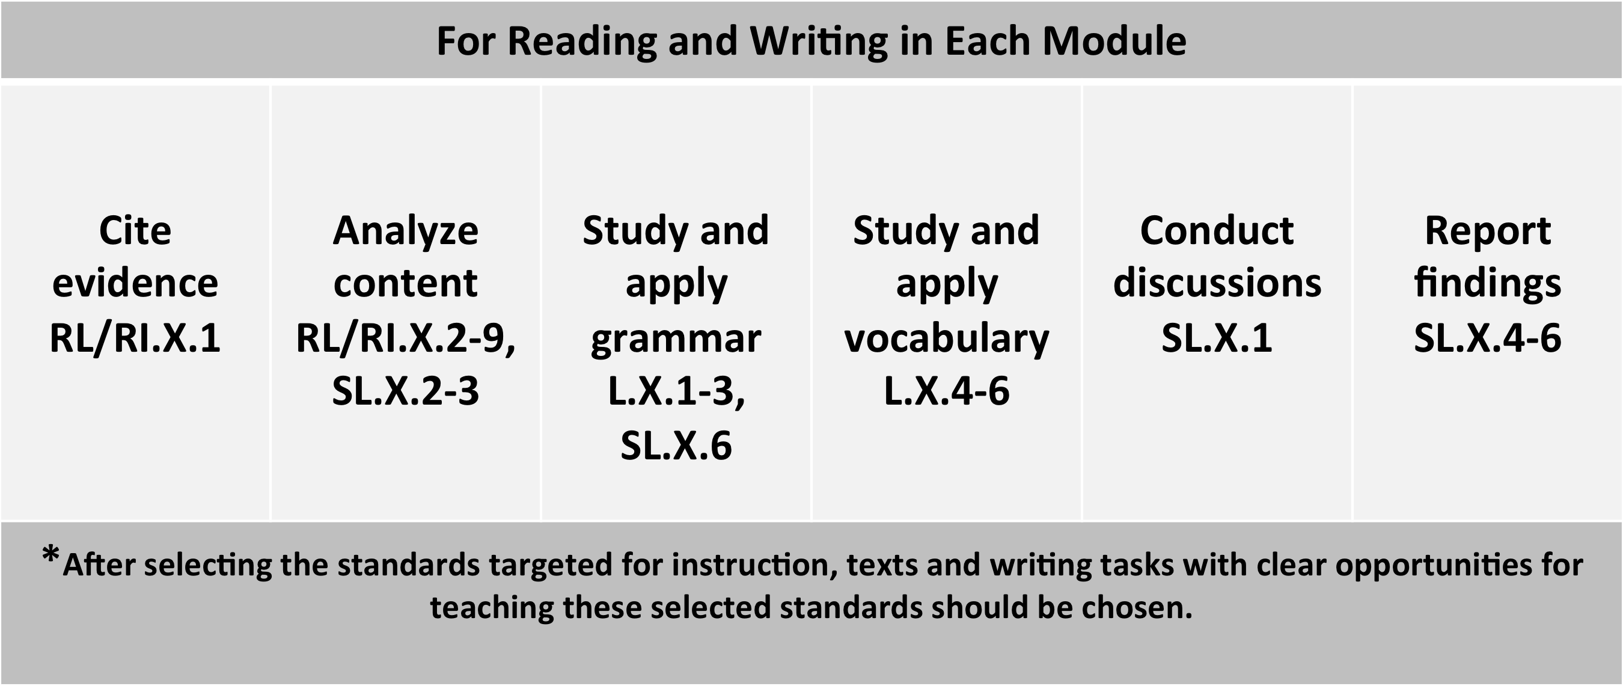
Standards that underpin the frameworks
Notes:
All of the tasks in the frameworks include the abilities/skills listed in the standards that underpin the frameworks. Each of these skills is an essential element when reading and writing about texts.

Slide 19
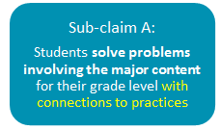
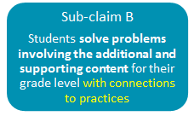
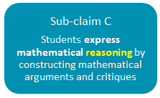
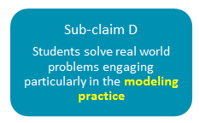
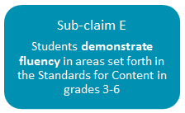
Claims Driving Design: Mathematics
Master Claim: On-Track for college and career readiness.
Students solve grade-level/course-level problems in mathematics as set forth in the Standards for Mathematical Content with connections to the Standards for Mathematical Practice.
Notes:
Turn to page 3 in your manual. Here you will find the PARCC Master Claim for Mathematics.
The PARCC assessment is based on the master claim:
“Students are on track or ready for college and careers.”
In understanding the claim we need to consider both:
The Common Core State Standards for Mathematical Practice
The Common Core State Standards for Mathematical Content
We will begin by investigating how the Mathematical Practices are embedded in the sub-claims.
The second sentence of the Master claim states: Students solve grade-level/course-level problems in mathematics as set forth in the Standards for Mathematical Content with connections to the Standards for Mathematical Practice.
For a short time, let’s focus on those bolded words that draw our attention to the Standards for Mathematical Practice.
Posted around the room you will see the 8 Standards for Mathematical Practice. Take just a moment to read these 8 Practice Standards.
Extension (or explanation or elaboration) of the Master Claim is shown in the 5 statements called sub-claims.
<*> The Practices are explicitly referred to in the first 2 sub-claims.
Students will solve problems “with connections to practices.” The topic of major content and additional and supporting content will be discussed in the next session.
<*>The 3rd sub-claim refers specifically to mathematical reasoning, which is the focus of Mathematical Practice 3 (Construct viable arguments and critique the reasoning of others). As students construct arguments, they must attend to precision with their use of vocabulary in the statements. The attention to precision is Mathematical Practice 6.
<*>The 4th sub-claim specifically mentions “modeling practice,” the focus of Mathematical Practice 4 (Model with mathematics). When students engage in modeling to solve appropriately difficult problems, they are likely to engage in one or more of the remaining Mathematical Practices.
<*>The last sub-claim is for grades 3-6 only and focuses on fluency, which can only be developed by engaging in many mathematical practices. We will examine fluency in a later session.

Slide 20
Practices Content
Teaching content without practices is possible.
Teaching practices without content is NOT possible.
Practices should be connected to specific content.
Notes:
Practices function differently from content in curriculum and instruction.
<*>It is possible to teach content without practices,
<*> but you cannot teach practices without content.
<*>Practices should be authentically connected to specific content.

Slide 21

Big Idea!!
The Practices will be well
represented on the
PARCC Assessment
Notes:
Here’s a statement to “tattoo on your forehead:” <*>The Mathematical Practice Standards will be well represented on the PARCC Assessment.
To accomplish this, PARCC will incorporate Practice-Forward Tasks.

Slide 22
Standards for Mathematical Practice
Where? Performance Based Assessment (PBA) End-of-Year Assessment (EOY) | What kind? Practice-Integrated Tasks Practice-Related Tasks
Which ones? Different ones with different frequencies | How many? At least one per content domain
Notes:
PARCC has used general statements like the ones in this activity when writing the specifications for these assessment tasks. And here are PARCC’s answers to some of the questions that everyone has about how the practices will be incorporated into the assessments.
PARCC assures us that the Mathematical Practices will be assessed on all of the PARCC assessments.

Slide 24
Sample Questions: PARCC Assessment
August 2012

Slide 25
PARCC’s Fundamental Advance
PARCC is designed to reward quality instruction aligned to the Standards, so the assessment is worthy of preparation rather than a distraction from good work.

Slide 26
PARCC’s Core Commitments to ELA/Literacy Assessment Quality
Texts Worth Reading: The assessments will use authentic texts worthy of study instead of artificially produced or commissioned passages.
Questions Worth Answering: Sequences of questions that draw students into deeper encounters with texts will be the norm (as in an excellent classroom), rather than sets of random questions of varying quality.
Better Standards Demand Better Questions: Instead of reusing existing items, PARCC will develop custom items to the Standards.
Fidelity to the Standards (now in Teachers’ hands): PARCC evidences are rooted in the language of the Standards so that expectations remain the same in both instructional and assessment settings.

Slide 27
What Are the Shifts at the Heart of PARCC Design (and the Standards)?
Complexity: Regular practice with complex text and its academic language.
Evidence: Reading and writing grounded in evidence from text, literary and informational.
Knowledge: Building knowledge through content rich nonfiction.

Slide 28
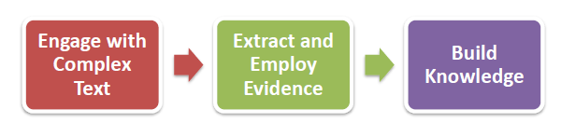
The CCSS Shifts Build Toward College and Career Readiness for All Students

Slide 29
Students’ Command of Evidence with Complex Texts is at the Core of Every Part of the Assessment!
SO. . .
Two standards are always in play—whether they be reading or writing items, selected-response or constructed-response items on any one of the four components of PARCC. They are:
  Reading Standard One (Use of Evidence)
  Reading Standard Ten (Complex Texts)

Slide 30
Three Innovative Item Types That Showcase Students’ Command of Evidence with Complex Texts
Evidence-Based Selected Response (EBSR)—Combines a traditional selected-response question with a second selected-response question that asks students to show evidence from the text that supports the answer they provided to the first question. Underscores the importance of Reading Anchor Standard 1 for implementation of the CCSS.
Technology-Enhanced Constructed Response (TECR)—Uses technology to capture student comprehension of texts in authentic ways that have been difficult to score by machine for large scale assessments (e.g., drag and drop, cut and paste, shade text, move items to show relationships).
Range of Prose Constructed Responses (PCR)—Elicits evidence that students have understood a text or texts they have read and can communicate that understanding well both in terms of written expression and knowledge of language and conventions. There are four of these items of varying types on each annual performance-based assessment.

Slide 31
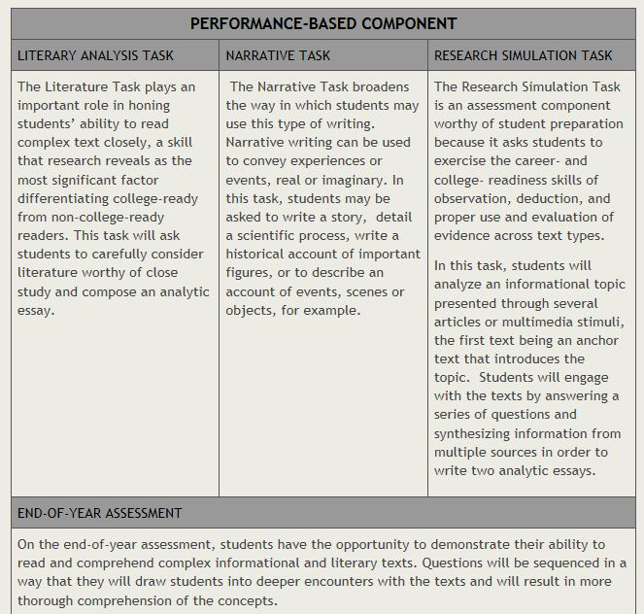
PARCC Summative Assessment with EBSR, TECR, and PCR Items

Slide 32
Questions Worth Answering?
On the following pages there is one Evidence-Based Selected-Response Item, one Technology Enhanced Constructed-Response Item, and one Prose Constructed Response Item that challenge students’ command of evidence with complex texts.

Slide 33
Grade 6 Prose Constructed-Response Item
In the passage, the author developed a strong character named Miyax. Think about Miyax and the details the author used to create that character. The passage ends with Miyax waiting for the black wolf to look at her.
Write an original story to continue where the passage ended. In your story, be sure to use what you have learned about the character Miyax as you tell what happens to her next.

Slide 34
Grade 6 Evidence-Based Selected-Response Item #1
Part A
What does the word “regal” mean as it is used in the passage?
generous
threatening
kingly*
uninterested
Part B
Which of the phrases from the passage best helps the reader understand the meaning of “regal?”
“wagging their tails as they awoke”
“the wolves, who were shy”
“their sounds and movements expressed goodwill”
“with his head high and his chest out”*

Slide 35
Grade 6 Evidence-Based Selected-Response Item #2
Part A
Based on the passage from Julie of the Wolves, how does Miyax feel about her father?
She is angry that he left her alone.
She blames him for her difficult childhood.
She appreciates him for his knowledge of nature.*
She is grateful that he planned out her future.
Part B
Which sentence from the passage best shows Miyax’s feelings for her father?
“She had been lost without food for many sleeps on the North Slope of Alaska.”
“This could be done she knew, for her father, an Eskimo hunter, had done so.”*
“Unfortunately, Miyax’s father never explained to her how he had told the wolf of his needs.”
“And not long afterward he paddled his kayak into the Bering Sea to hunt for seal, and he never returned.”

Slide 36
Grade 6 Technology-Enhanced Selected-Response Item
Part A
Choose one word that describes Miyax based on evidence from the text. There is more than one correct choice listed below.
reckless
lively
imaginative*
observant*
impatient
confident
Part B
Find a sentence in the passage with details that support your response to Part A. Click on that sentence and drag and drop it into the box below.
Part C
Find a second sentence in the passage with details that support your response to Part A. Click on that sentence and drag and drop it into the box below.

Slide 37
PARCC’s Core Commitments to Mathematics Assessment Quality
Focus: PARCC assessments will focus strongly on where the Standards focus. Students will have more time to master concepts at a deeper level.
Problems worth doing: Multi-step problems, conceptual questions, applications, and substantial procedures will be common, as in an excellent classroom.
Better Standards Demand Better Questions: Instead of reusing existing items, PARCC will develop custom items to the Standards.
Fidelity to the Standards (now in Teacher’s hands): PARCC evidences are rooted in the language of the Standards so that expectations remain the same in both instructional and assessment settings.

Slide 38
What Are the Shifts in the Math Standards at the Heart of PARCC Design?
Focus: The PARCC Assessment will focus strongly where the Standards focus
Coherence: Think across grades and link to major topics within grades
Rigor: In major topics, pursue conceptual understanding, procedural skill and fluency, and application.

Slide 39
Advances in Assessment Demanded by the Shifts
Shift #1 – Focus: The PARCC assessments will focus strongly where the Standards focus
Advance: PARCC assessments will focus strongly where the Standards focus (70% or more on the major work in grades 3-8).
Focus allows for a variety of problem types to get at concept in multiple ways.
Students will have more time to master concepts at a deeper level.

Slide 40
Advances in Assessment Demanded by the Shifts
Shift #2 - Coherence: Think across grades, and link to major topics within grades
Advance: The assessment design is informed by multi-grade progressions in the Standards and the Model Content Frameworks.
Key beginnings are stressed (e.g., ratio concepts in grade 6), as are key endpoints and takeaway skills (e.g., fluency with the multiplication table in grade 3).

Slide 41
Advances in Assessment Demanded by the Shifts
Shift #2 - Coherence: Think across grades, and link to major topics within grades
Advance: Integrative tasks draw on multiple standards to ensure students are making important connections.
The Standards are not treated as a checklist.

Slide 42
Advances in assessment demanded by the shifts
Shift #3 - Rigor: In major topics, pursue conceptual understanding, procedural skill and fluency, and application
Advance: PARCC assessments will reach the rigor in the Standards through innovations in technology and item design…

Slide 43
Sample Items Illustrating the Advances in Assessment
The next section of this presentation is comprised of sample items that illustrate some of the advances called for by the three shifts.

Slide 44
Overview of Mathematics Task Types
PARCC mathematics assessments will include three types of tasks.
Task Type | Description of Task Type
I. Tasks assessing concepts, skills and procedures | Balance of conceptual understanding, fluency, and application Can involve any or all mathematical practice standards Machine scorable including innovative, computer-based formats Will appear on the End of Year and Performance Based Assessment components
II. Tasks assessing expressing mathematical reasoning | Each task calls for written arguments / justifications, critique of reasoning, or precision in mathematical statements (MP.3, 6). Can involve other mathematical practice standards May include a mix of machine scored and hand scored responses Included on the Performance Based Assessment component
III. Tasks assessing modeling / applications | Each task calls for modeling/application in a real-world context or scenario (MP.4) Can involve other mathematical practice standards. May include a mix of machine scored and hand scored responses Included on the Performance Based Assessment component
For more information see PARCC Item Development ITN Appendix D.

Slide 45
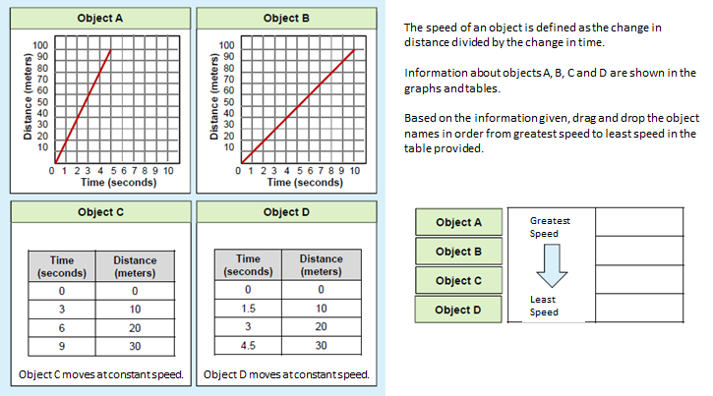
Grade 7 Illustrative Sample Item

Slide 46
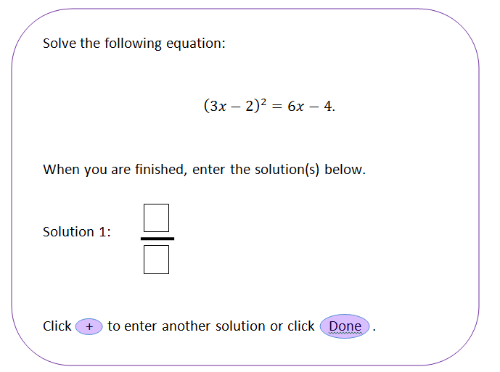
High School Illustrative Sample Item
Seeing Structure in a Quadratic Equation

Slide 47
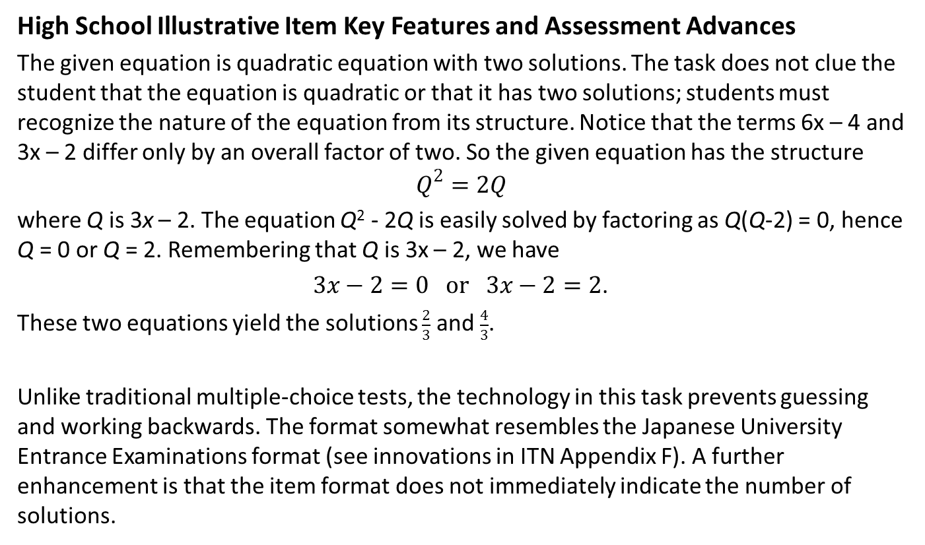
Aligns to the Standards and Reflects Good Practice
High School Illustrative Item Key Features and Assessment Advances
The given equation is quadratic equation with two solutions. The task does not clue the student that the equation is quadratic or that it has two solutions; students must recognize the nature of the equation from its structure. Notice that the terms 6x – 4 and 3x – 2 differ only by an overall factor of two. So the given equation has the structure
$$Q^{2}=2Q$$
where Q is 3x – 2. The equation Q² - 2Q is easily solved by factoring as Q(Q-2) = 0, hence Q = 0 or Q = 2. Remembering that Q is 3x – 2, we have
$3x−2=0 or 3x−2=2$.
These two equations yield the solutions $\frac{2}{3}$ and $\frac{4}{3}$.
Unlike traditional multiple-choice tests, the technology in this task prevents guessing and working backwards. The format somewhat resembles the Japanese University Entrance Examinations format (see innovations in ITN Appendix F). A further enhancement is that the item format does not immediately indicate the number of solutions.

Slide 48


PARCC Take-Aways
Two Things to Tell Teachers
Two Things to Start to Plan

