Slide 1
The Partnership for Assessment of Readiness for College and Careers
September 13th, 2011
Alliance for Excellent Education

Slide 2
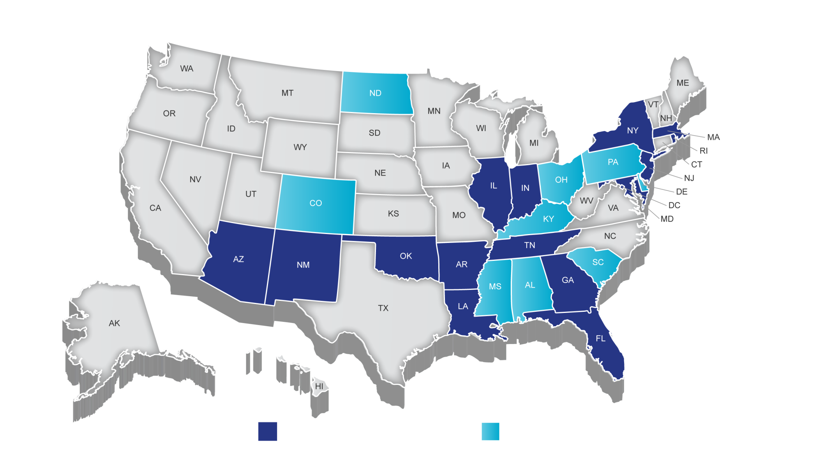
Partnership for Assessment of Readiness for College and Careers (PARCC)
Governing Board States Participating States

Slide 3
PARCC Goals
Create high-quality assessments
Build a pathway to college and career readiness for all students
Support educators in the classroom
Develop 21st century, technology-based assessments
Advance accountability at all levels

Slide 4
PARCC Assessment Priorities
Determine whether students are college- and career-ready or on track
Compare performance across states and internationally
Assess the full range of the Common Core Standards, including standards that are difficult to measure
Measure the full range of student performance, including the performance of high and low performing students
Provide data during the academic year to inform instruction, interventions and professional development
Provide data for accountability, including measures of growth
Incorporate innovative approaches throughout the system

Slide 5
Refinements to the PARCC Assessment Design
The PARCC assessment system will be comprised of four components. Each component will be computer-delivered and will leverage technology to incorporate innovations.
Two required summative assessment components
Performance-Based Assessment (PBA)
End-of-Year Assessment (EOY)
Two optional formative/diagnostic assessment components
Diagnostic Assessment
Mid-Year Assessment

Slide 6
The PARCC Assessment Design
English Language Arts/Literacy and Mathematics, Grades 3-11
Flexible
Diagnostic Assessment
Early indicator of student knowledge and skills to inform instruction, supports, and PD
Mid-Year Assessment
Performance-based
Emphasis on hard-to-measure standards
Potentially summative
Performance-Based
Assessment (PBA)
Extended tasks
Applications of concepts and skills
End-of-Year
Assessment
Innovative, computer-based items
Speaking
And
Listening
Summative assessment for accountability
Formative assessment

Slide 7
The Partnership for Assessment of Readiness for College and Careers
September 13th, 2011
www.PARCConline.org

