Slide 1
Developing as an Inquiry Team
Theresa Gray, Coordinator
Integrated Education Services
Erie 2-Chautauqua-Cattaraugus BOCES
RCC: January 25, 2012

Slide 2
Objectives
Review key elements of data driven instruction
Develop a focus for your Inquiry Team
Identify Assessments
Create Action Steps

Slide 3
What is School Based Inquiry?
Brainstorm 4-6 things that come to mind around School Based Inquiry
Turn to a partner and share your list
“Popcorn” one word/phrase from your list

Slide 4
Consider this definition…
Inquiry work is, in essence, about how empowered educators work together. It is about teams of teachers and administrators taking responsibility for student outcomes, which can look different in different schools. The goal in all cases is to support and build on each team member's professionalism, and to inspire each team's creative and self-motivated exercise of responsibility for accelerating student learning.

Slide 5
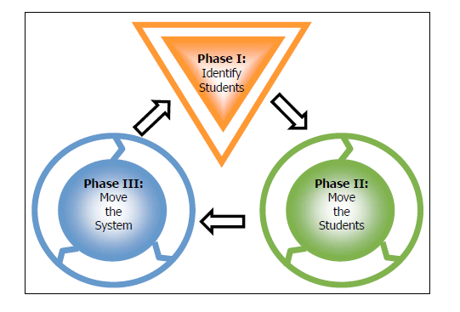
A Big Picture Look at Inquiry
From NYC Inquiry Team Handbook (2008)

Slide 6
Four Key Principles
ACTION
Analysis
Assessment
School Culture

Slide 7
Data Driven Instruction & School-Based Inquiry
District Level Analysis (1,000 ft. view)
School-Based Inquiry
Department or Grade Level
Teacher
NYS Assessments
NYS Assessments
Interim Assessments
Interim Assessments
Interim Assessments
Formative Assessments
From IT Conference, 2011

Slide 8
Possible Assessments
Interim Assessments
Unit Tests/Mid-Terms
Student Work Samples
Writing
Math problems

Slide 9
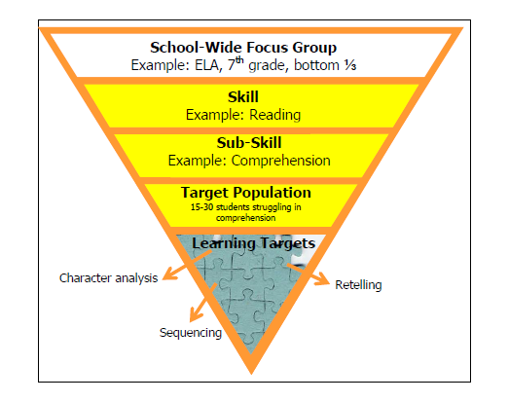
Drilling Down to Target Population

Slide 10
Four Key Principles
ACTION
Analysis
Assessment
School Culture

Slide 11
Action
“The only thing I fear more than change is no change. The business of being static makes me nuts.”
-Twyla Tharp
“Insanity: doing the same thing over and over again and expecting different results.” -Albert Einstein
“The things we fear most in organizations—fluctuations, disturbances, imbalances—are the primary sources of creativity.”
— Margaret J. Wheatley

Slide 12
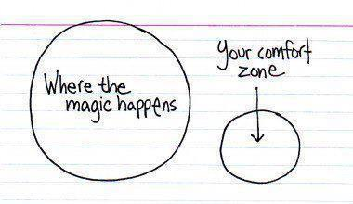

Slide 13
You might be practicing School Based Inquiry IF
Instead of…
Having department or grade level meetings to discuss kids, field trips, budgets, the administration….
You are…
Analyzing student work or assessments to determine strengths, weaknesses and determine next steps…
AND YOU DO THEM!

Slide 14
You might be practicing School Based Inquiry IF
Instead of…
Having a conversation with a teacher about how their students are doing….
You are…
Have a conversation about how students are doing that is based on data (test in hand) and together you discuss/plan changes…
AND YOU OBSERVE THEM

Slide 15
You might be practicing School Based Inquiry IF
Instead of…
Sharing our opinions of student learning and quality teaching…
You are…
Looking at student work and to see what “really works” and using that work as evidence…
AND YOU CHANGE YOUR INSTRUCTION

Slide 16
You might be practicing School Based Inquiry IF
Instead of…
Expecting an RTI team to “fix” a problem with students…
You are…
Bringing student work samples and data to a meeting, discussing Tier 1 interventions…
AND YOU
IMPLEMENT THEM

Slide 17
You might be practicing School Based Inquiry IF
Instead of…
Checking a box that you have an Inquiry Team in place…
You are…
Using an Inquiry Team and School Based Inquiry to investigate learning aligned to a district goal..
AND YOU MAKE CHANGES
(Rinse-Lather-Repeat)

Slide 18
Round-Table Discussion
What do you have in place that might be a starting place for School Based Inquiry?
What is driving that inquiry?
What obstacles to implementing School Based Inquiry do you perceive?
What might you do to overcome them?
What can you go back and do this week?

