Slide 1
APPR Plan Portal
Submitting your APPR plan using the required online SED portal

Slide 2
APPR Plan Portal
Developed just for NYS APPR
Each district must submit their plan using this tool.
Each district will have a username and password sent to superintendent’s email.
https://nysed-appr.myreviewroom.com/a/

Slide 3
NYSED APPR Form
All districts will have a username and password
3

Slide 4
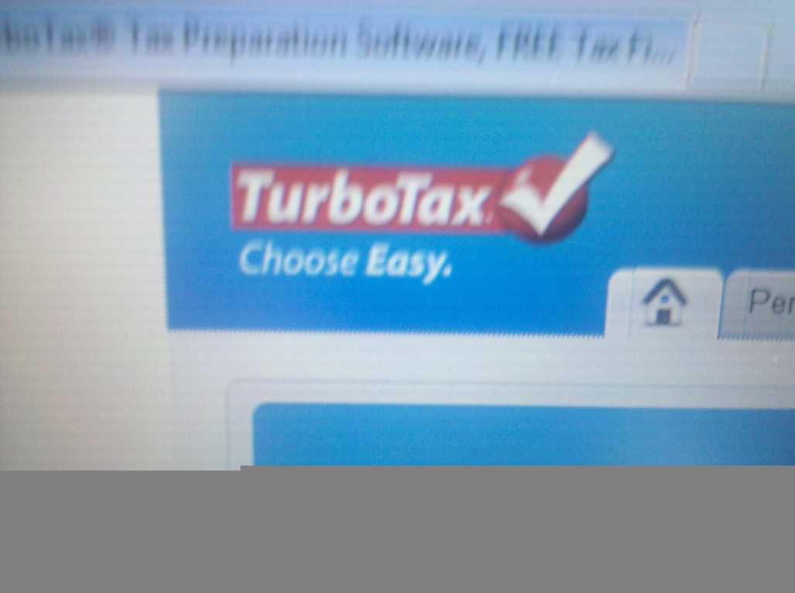
APPR Plan Portal
The system has the requirements for APPR in NYS embedded in it.

Slide 5
APPR Plan Portal
The system will not allow a district to submit the plan until all elements are completed.

Slide 6
System Highlights
All required tasks are available as word documents on the “Resources” page.
Read only access can be granted.
Some documents must be downloaded, signed, then uploaded.
The district’s logo can be uploaded.

Slide 7
System Highlights
It’s possible to work on one section of required APPR plan elements, save them and come back later.
IT IS ALSO NECESSARY TO SAVE YOUR WORK WHEN SWITCHING FROM ONE AREA TO ANOTHER.

Slide 8
NYSED APPR Form
Keep in Mind: the “Resource Tab” is where you will find helpful items such as the State-approved list of 3rd party assessments
These are the file types that can be uploaded to Review Room

Slide 9
NYSED APPR Form
Some pages have dropdown boxes. Where there are dropdown boxes, you often will see a blank box next to it, like on this page. Here you are asked to actually name the specific assessment. You would type that into the blank box.

Slide 10
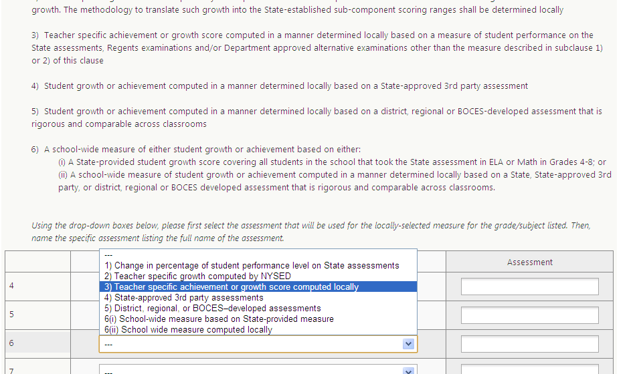
NYSED APPR Form
Don’t get confused!
The dropdown boxes include an abbreviated list of what is above.

Slide 11
Online Form vs. Model Language
ALL districts MUST use the online form to submit their locally negotiated plan for SED approval.
Districts are free to explore all sorts of resources for model language like MASLA, NYSUT or others.

Slide 12
Important Dates
July 1 – submission of APPR Plan to the Department
September 10 – posting of APPR Plan
January 17 – An approved APPR plan must be in place or the district will not be eligible for increases in state aid.
12
Notes:
Quote Ken about how there a different consequences for filing at any of these points.
12

Slide 13
Other New APPR Resources
Expanded Guidance with Q and A
Road Maps for Teacher and Principal Evaluation Road Maps for 2012-13

